Slide 1
Centralized Monitoring

Slide 2
Importance
VCF Operations collects data for the applications and services running in your virtual environment with Cloud Proxy and Telegraf agent.
As a VCF Operations administrator, you must understand the concepts of application monitoring and service discovery in VCF Operations. Then you must use these capabilities to ensure and optimize the performance of your environment.

Slide 3
Module Lessons
Infrastructure and Application Monitoring Overview
Service Discovery
Application Monitoring

Slide 4
Infrastructure and Application Monitoring Overview

Slide 5
Learner Objectives
Describe the infrastructure services monitoring capabilities
Describe the application monitoring capabilities
Outline the requirements to enable service discovery
Outline the requirements to enable application monitoring

Slide 6
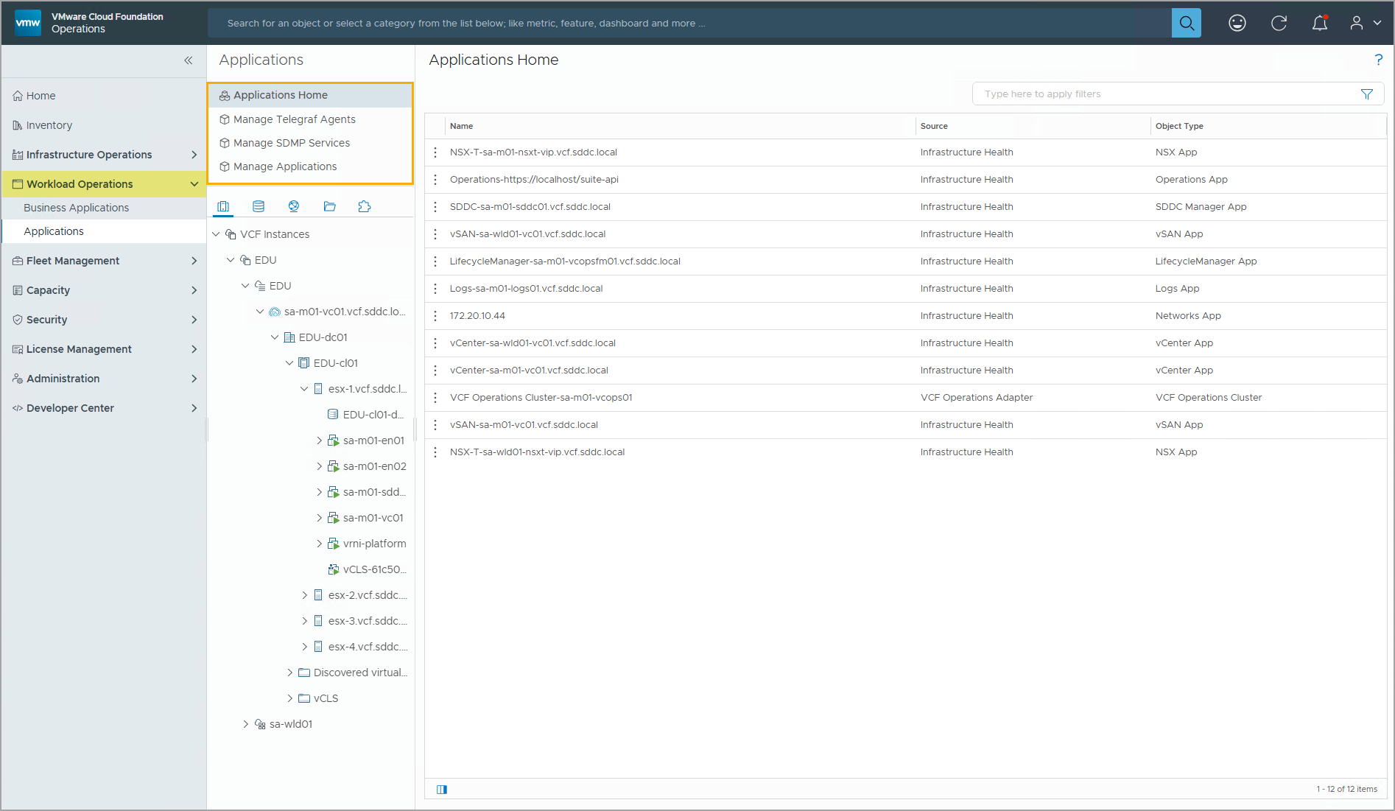
Understanding Service and Application Discovery
You can discover services and applications using the Workload Operations capabilities in the VCF Operations console.
Notes:
TalkTrack:
Services and applications can be discovered using Workload Operations capabilities in the VCF Operations console.
<End>

Slide 7
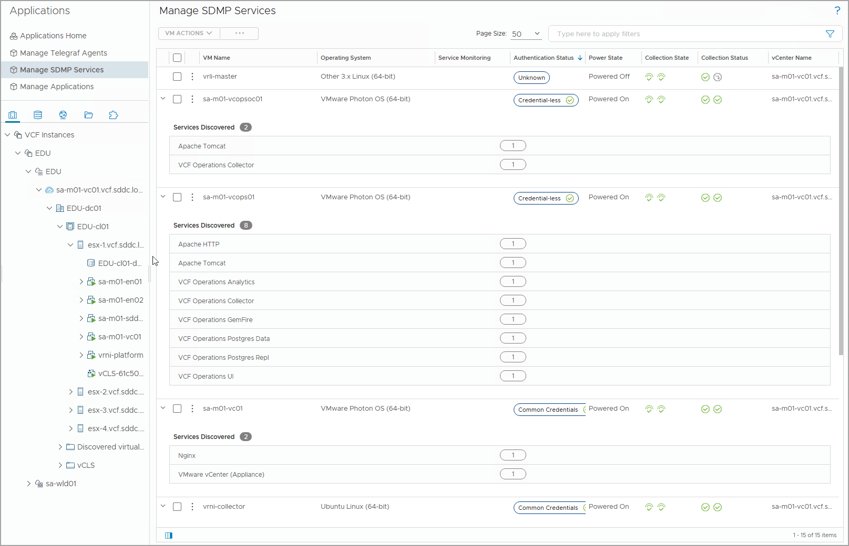
Service Discovery Overview
Service discovery helps you discover services running in each VM and builds a relationship or dependency between the services from different VMs.
You can also use the service discovery dashboards and basic metrics to monitor the services.
Service discovery is agentless and relies on VMware Tools to gather data.
Notes:
TalkTrack:
Service discovery helps identify services running in each virtual machine and relationships or dependencies between services from different virtual machines. The service discovery dashboard and basic metrics can also be used to monitor services. Service discovery is agentless and relies on VMware Tools to gather data. Determining which virtual machine is part of a service and the impact of a shifting cluster or moving a virtual machine is possible. This helps determine the impact of an incident and the right escalation path for a problem. Additionally, it can determine which virtual machines are used to migrate a service and which services are impacted by a planned outage on a virtual machine or an infrastructure component. Service discovery supports specific platforms, including Windows Server 2008 R2 and above. It also supports Photon, RHEL 6, CentOS 6, SLES 11, and Ubuntu 12.04 Linux operating systems, with kernel versions 2.6.27 or above.
<End>
You can determine which VM is a part of a service and the impact of shutting down or moving a VM. You can also determine the impact of an incident and the right escalation path for a problem. In addition, you can determine which VMs are used to migrate a service and which services are impacted by a planned outage on a VM or an infrastructure component.
For all supported product version for credential-based service discovery, please see the technical documentations at https://techdocs.broadcom.com/us/en/vmware-cis/vcf/vcf-9-0-and-later/9-0/workload-monitoring-and-observability/about-service-discovery/supported-platforms-and-products-for-service-discovery.html
Service discovery supports specific platforms:
Windows 7, Windows Server 2008/R2, and above
Photon, RHEL, CentOS, SUSE Linux Enterprise Server, OEL, and Ubuntu (all Linux operating systems must be based on kernel version 2.6.25 or above)

Slide 8
Supported Services
Service and application discovery supports several services that are supported in VCF Operations. The following list shows some supported services:
Active Directory
Apache HTTP and Apache Tomcat
Cassandra
Exchange Server
MySQL DB
Nginx
RabbitMQ
SharePoint
vCenter
Notes:
TalkTrack:
Service and application discovery supports several services in VCF Operations. Some of these supported services include Active Directory, Apache HTTP and Apache Tomcat, Cassandra, Exchange Server, MySQL DB, Nginx, RabbitMQ, Sharepoint, and VMware vCenter.
<End>
For a complete list of supported services, please see the technical documentation at https://techdocs.broadcom.com/us/en/vmware-cis/vcf/vcf-9-0-and-later/9-0/workload-monitoring-and-observability/about-service-discovery/supported-services.html.

Slide 9
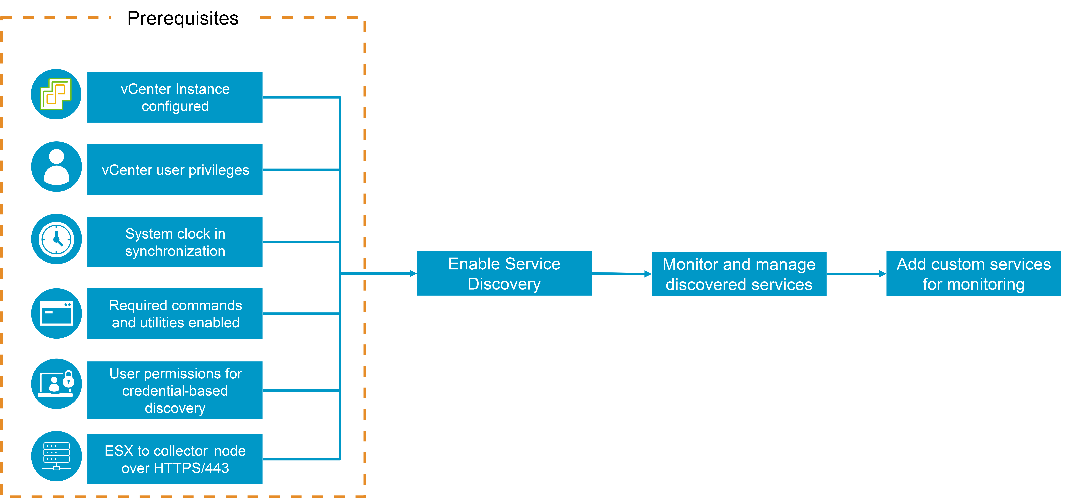
Service Discovery Prerequisites
To use the service discovery function in your environment, you must ensure that the prerequisites are fulfilled.
Notes:
TalkTrack:
To use the service discovery function in an environment, certain prerequisites must be met. A vCenter Adapter instance must be configured and monitoring the same vCenter where services are to be discovered. The configured vCenter user needs the necessary privileges for credential-based or credential-less service discovery. The ESX instance hosting the virtual machines must have access to the collector node where the service discovery adapter instance is configured over HTTPS/443. The system clocks of the VCF Operations nodes, the vCenter, and the virtual machines must be synchronized. Required commands and utilities must be enabled on the target virtual machines. For credential-based service discovery, the required user permissions must be configured correctly.
<End>
The list below summarizes the prerequisites:
A vCenter Adapter instance must be configured and is monitoring the same vCenter that is used to discover services.
The configured vCenter user must have the required privileges for the intended credential-based service discovery or credential-less service discovery.
The ESX instance that hosts the VMs must have access to the collector node on which the service discovery adapter instance is configured over HTTPS/443.
The system clock of the VCF Operations nodes, the vCenter, and the VMs must be synchronized.
The required commands and utilities must be enabled on the target VMs.
For credential-based service discovery, the required user permissions must be configured properly.
For a complete list of prerequisites and required user account permissions, please see the technical documentation at https://techdocs.broadcom.com/us/en/vmware-cis/vcf/vcf-9-0-and-later/9-0/workload-monitoring-and-observability/about-service-discovery/configure-service-and-application-discovery.html.

Slide 10
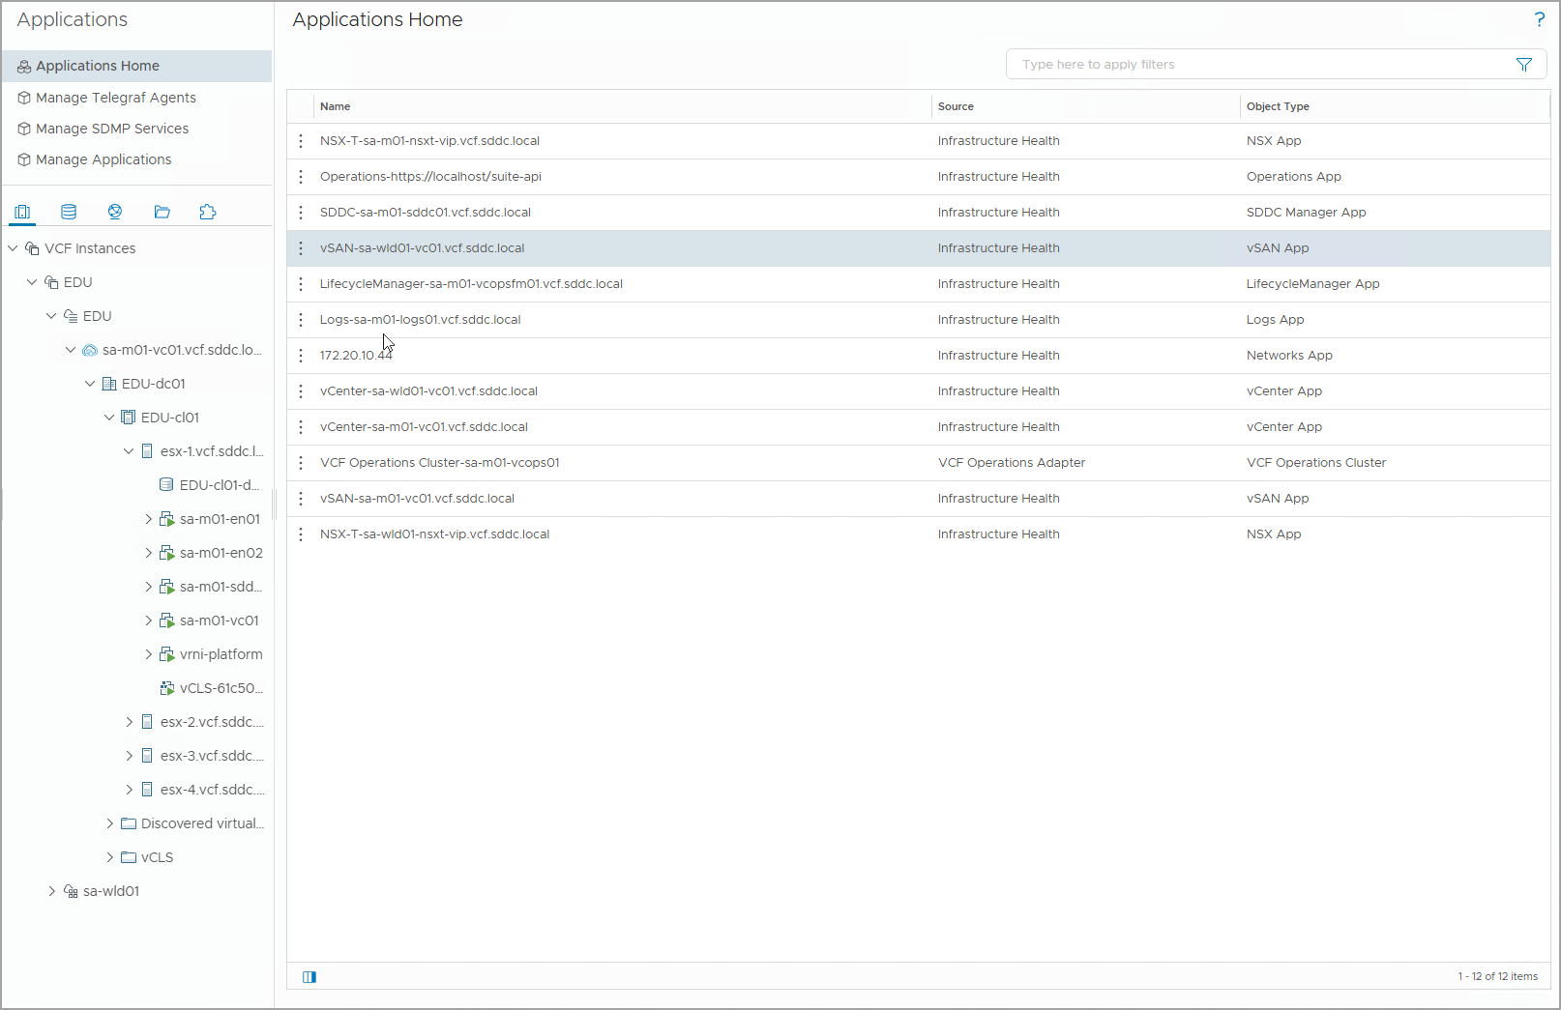
Application Monitoring Overview
Application and operating system monitoring enables virtual infrastructure administrators and application administrators to discover operating systems and applications at scale and collect run-time metrics for monitoring and troubleshooting.
You can monitor application services in the VCF Operations console. You can also manage the life cycle of Telegraf agent and application services on virtual machines.
Notes:
TalkTrack:
Application and operating system monitoring allows virtual infrastructure administrators and application administrators to discover operating systems and applications at scale. It also enables collecting run-time metrics for monitoring and troubleshooting. Application services in the VCI Operations console can be monitored. The lifecycle of Telegraf agents and application services on virtual machines can also be managed. As an administrator, ensuring the infrastructure for running application services is sufficient and free of problems is important. If an application service is not performing correctly or is slow, troubleshooting can be done by examining the infrastructure on which the application is deployed. VCI Operations can deploy the Telegraf agent to return relevant application data. This data can be viewed in VCI Operations and shared with the team to troubleshoot the application service.
<End>
For example, as an administrator, you might need to ensure that the infrastructure provided for running the application services is sufficient and that problems do not occur. If you receive a complaint that a particular application service is not working properly or is slow, you can troubleshoot by looking at the infrastructure on which the application is deployed.
You can use VCF Operations to deploy the Telegraf agent that return relevant application data to VCF Operations. You can view the data in VCF Operations and can share it with the team so that the team can troubleshoot the application service.

Slide 11
Supported Application Services
OS and application monitoring can collect run-time metrics of the operating system and application for monitoring and troubleshooting respective entities.
The following list shows some supported application services:
Active Directory
Apache HTTPD
HyperV
Java Application
Mongo DB
MS Exchange
Oracle DB
The following list shows the supported VeloCloud application services:
VeloCloud Orchestrator
Nginx
Clickhouse
Network Time Protocol
MySQL
Redis
Java Application
VeloCloud Gateway
Notes:
TalkTrack:
OS and application monitoring can collect run-time metrics of the operating system and applications for monitoring and troubleshooting. The supported application services include Active Directory, Apache HTTPD, HyperV, Java Application, Mongo DB, MS Exchange, Oracle DB, and more. The supported VeloCloud Director application services include VeloCloud Orchestrator, Nginx, Clickhouse, Network Time Protocol, MySQL, Redis, Java Application, and VeloCloud Gateway.
<End>
For a complete list of supported application services, please see the technical documentation at https://techdocs.broadcom.com/us/en/vmware-cis/vcf/vcf-9-0-and-later/9-0/workload-monitoring-and-observability/os-and-application-monitoring/supported-application-services.html.

Slide 12
OS and Application Monitoring Prerequisites
A successful OS and application monitoring requires the completion of a series of prerequisites on ports, user permissions, and network communications.
Notes:
TalkTrack:
A successful OS and application monitoring setup requires a series of prerequisites regarding ports, user permissions, and network communications. Communication between cloud proxy and target virtual machines is necessary. Target machines must be reachable via IP and FQDN on 443 via HTTPS. Target machines must have access to ports 443, 4505, and 4506 on the cloud proxy. The virtual IP of the application monitoring high availability activated collector group is also required. Communication between the cloud proxy and vCenter is also a prerequisite. Port 443 on the ESX where the workload virtual machines are deployed must be accessible to the cloud proxy. Port 443 in Platform Services Controller and vCenter is accessible to the cloud proxy. Configuring a vCenter adapter requires the vCenter user to have read access at the vCenter Server level. Guest operation modifications, guest operation program execution, and guest operation queries are also necessary permissions. User account prerequisites apply. On Windows target machines, the Telegraf agent installation requires a user account that is either an administrator or a non-administrator belonging to the administrator group. On Linux target machines, the /tmp mount point should be mounted with exec mount option. Specific minimum permissions for the user to install agents are required and should be mentioned in sudoers file. For example, a user called telegrafhostd can find the sudoers file in the /etc/sudoers file or in the /etc/sudoers.d/ directory. The required commands include DEBIAN_FRONTEND=noninteractive, INSTALL_TELEGRAF_CMD, INSTALL_TELEGRAF_ADDITIONAL_CMD, and INSTALL_TELEGRAF_CLEANUP_CMD.
<End>
For a complete list of prerequisites, please check the technical documentation at https://techdocs.broadcom.com/us/en/vmware-cis/vcf/vcf-9-0-and-later/9-0/workload-monitoring-and-observability/os-and-application-monitoring/prerequisites.html.
Communication between cloud proxy and target machine(s):
Target machine(s) should be able to reach cloud proxy via IP and FQDN on 443 via HTTPS.
Target machine(s) must have access to ports 443, 4505, and 4506 on cloud proxy and on the virtual IP of the application monitoring high availability activated collector group.
Communication between cloud proxy and vCenter:
Port 443 in the ESX where the workload VMs are deployed must be accessible to cloud proxy.
Port 443 in Platform Services Controller and vCenter is accessible to cloud proxy.
Configure a vCenter adapter. The vCenter user should have read access at the vCenter Server level and should also have the following permissions: Guest operation modifications, Guest operation program execution, and Guest operation queries.
User Account Prerequisites:
On Windows target machines: Telegraf agent installation requires a user account that is either an administrator or a non-administrator who belongs to the administrator group
On Linux target machines:
/tmp mount point should be mounted with exec mount option.
The following are minimal necessary permissions of the user to install agents and should be mentioned in sudoers file:
For example, for a user called telegrafinstall, you can find the sudoers file in the /etc/sudoers file or in the folder /etc/sudoers.d/:
Defaults:telegrafinstall !requiretty Cmnd_Alias ARC_INSTALL_USER_COMMANDS=/usr/bin/cp*,/bin/cp*,/usr/bin/mkdir*,/bin/mkdir*,/usr/bin/chmod*,/bin/chmod*,/opt/vmware/ucp/bootstrap/uaf-bootstrap.sh,/opt/vmware/ucp/ucp-minion/bin/ucp-minion.sh telegrafinstall ALL=(ALL)NOPASSWD: ARC_INSTALL_USER_COMMANDS

Slide 13
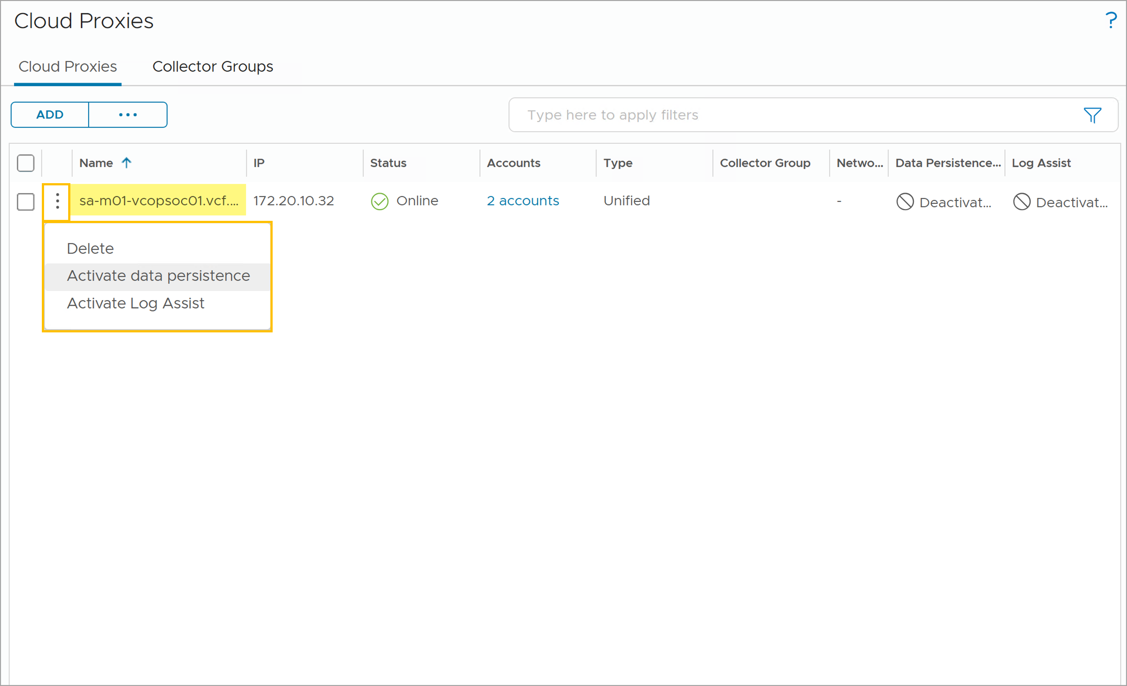
About Cloud Proxies
Cloud Proxies can collect and monitor data from your remote data centers and public clouds by creating one-way communications between your environment and VCF Operations.
Deploy the Cloud Proxy appliance in the same vCenter instance as the VMs that you want to monitor. You can deploy multiple cloud proxies in your environment.
To view existing cloud proxies and deploy new ones, navigate to Administration > Cloud Proxies.
Notes:
TalkTrack:
Cloud proxies can collect and monitor data from remote data centers and public clouds. This is achieved by creating one-way communications between an environment and VCF Operations. The Cloud Proxy appliance should be deployed in the same vCenter instance as the virtual machines intended for monitoring. Multiple cloud proxies can be deployed in an environment. Existing cloud proxies can be viewed, and new ones can be deployed by navigating to Administration then Cloud Proxies.
<End>

Slide 14
Review of Learner Objectives
Describe the infrastructure services monitoring capabilities
Describe the application monitoring capabilities
Outline the requirements to enable service discovery
Outline the requirements to enable application monitoring

Slide 15
Service Discovery

Slide 16
Learner Objectives
Enable service discovery for a VCF deployment
Perform actions enabled by the native service discovery
Enable service monitoring
Describe the different types of service metrics
Use collected metrics to interpret the status of services

Slide 17
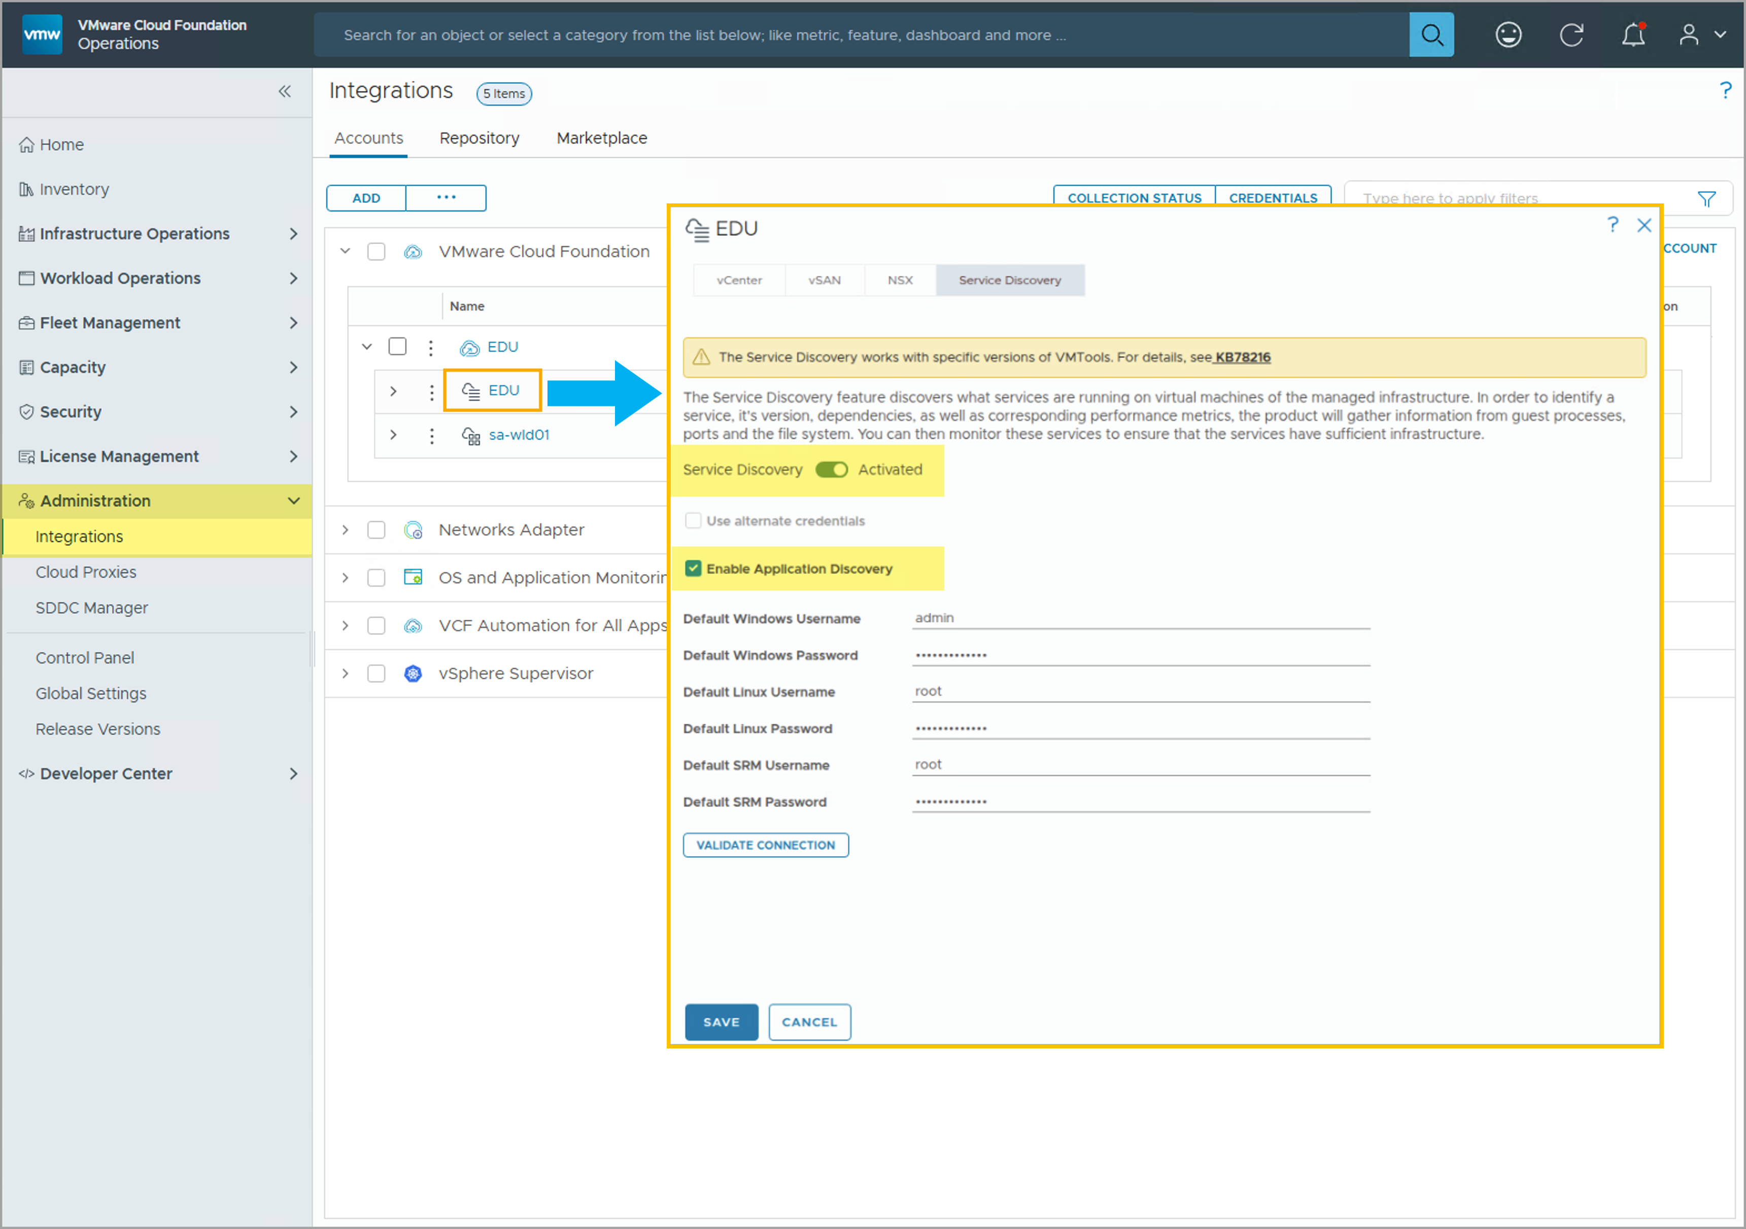
Activating Service Discovery in VCF Operations
To use Service Discovery in your VCF Operations console, you first need to enable and configure the Service Discovery settings.
Notes:
TalkTrack:
To use Service Discovery in the VCF Operations console, first enable and configure the Service Discovery settings. To enable Service Discovery settings, navigate to Administrations, then Integrations, and complete the following steps. Expand VMware Cloud Foundation and select the vCenter instance. Select Domains and then the Service Discovery tab. Toggle Service Discovery to Activated. Select the Enable Application Discovery checkbox. Optionally, configure user account credentials for credential-based service discovery. Finally, click Save This Domain and then Save.
<End>
To enable the Service Discovery settings, navigate to Administrations > Integrations, then complete the following steps:
Expand VMware Cloud Foundation, and select the vCenter instance.
Select Domains and select the Service Discovery tab.
Select the Service Discovery toggle to Activated.
Select the Enable Application Discovery checkbox.
(Optional) Configure the user account credentials if you wish to use credential-based service discovery.
Click Save This Domain and click Save.

Slide 18
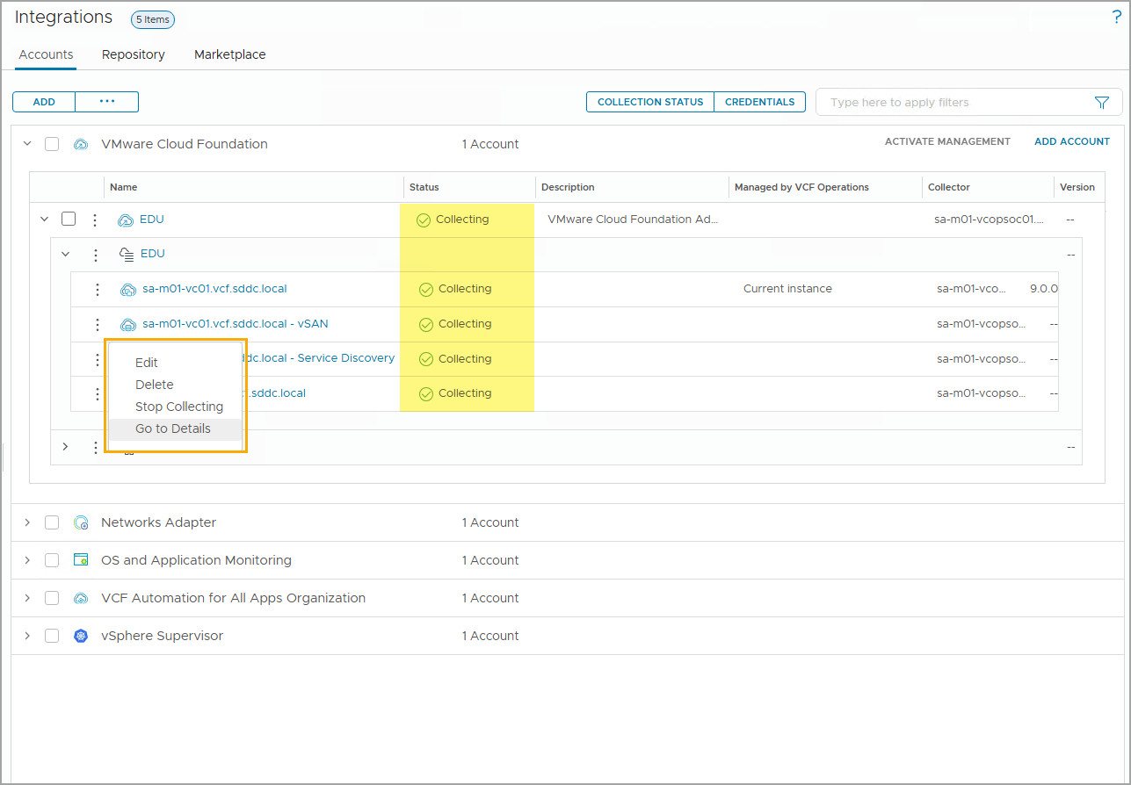
Examining Service Discovery Collection Status
When the Service Discovery settings are activated and configured, a Service Discovery adapter instance is created.
You can monitor the collection status from the Administrations > Integrations page. You can use the management options to:
Edit: Modify the Service Discovery adapter instance settings.
Delete: Delete the Service Discovery adapter instance.
Start/Stop Collecting: Start or stop the Service Discovery collection.
Go to Details: View the details of the Service Discovery adapter instance.
Notes:
TalkTrack:
Once Service Discovery settings are activated and configured, a Service Discovery adapter instance is created. The collection status can be monitored from the Administrations, then Integrations page. Management options include editing, modifying the Service Discovery adapter instance settings, deleting the Service Discovery adapter instance, or starting or stopping the Service Discovery collection. Details of the Service Discovery adapter instance can also be viewed.
<End>

Slide 19
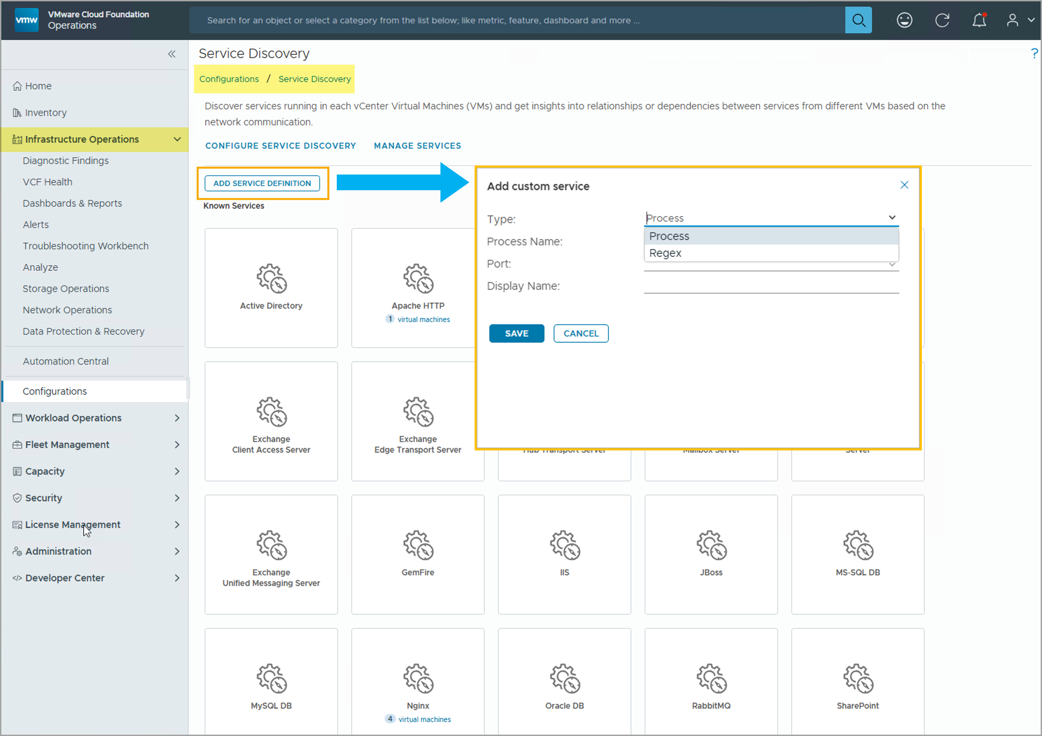
Adding Custom Service
You can add one or more custom services for monitoring. The custom services are evaluated against all virtual machines where service discovery is enabled.
To add a custom service, navigate to Infrastructure Operations > Configurations and click Service Discovery.
Click Add Service Definition.
Specify the process details (Process) or use a regular expression (Regex) to add the custom service.
Notes:
TalkTrack:
One or more custom services can be added for monitoring. These custom services are evaluated across all virtual machines where service discovery is enabled. To add a custom service, navigate to Infrastructure Operations, then Configurations, and click Service Discovery. Click Add Service Definition. The custom service can be chosen by specifying the process details or by using a regular expression.
<End>

Slide 20
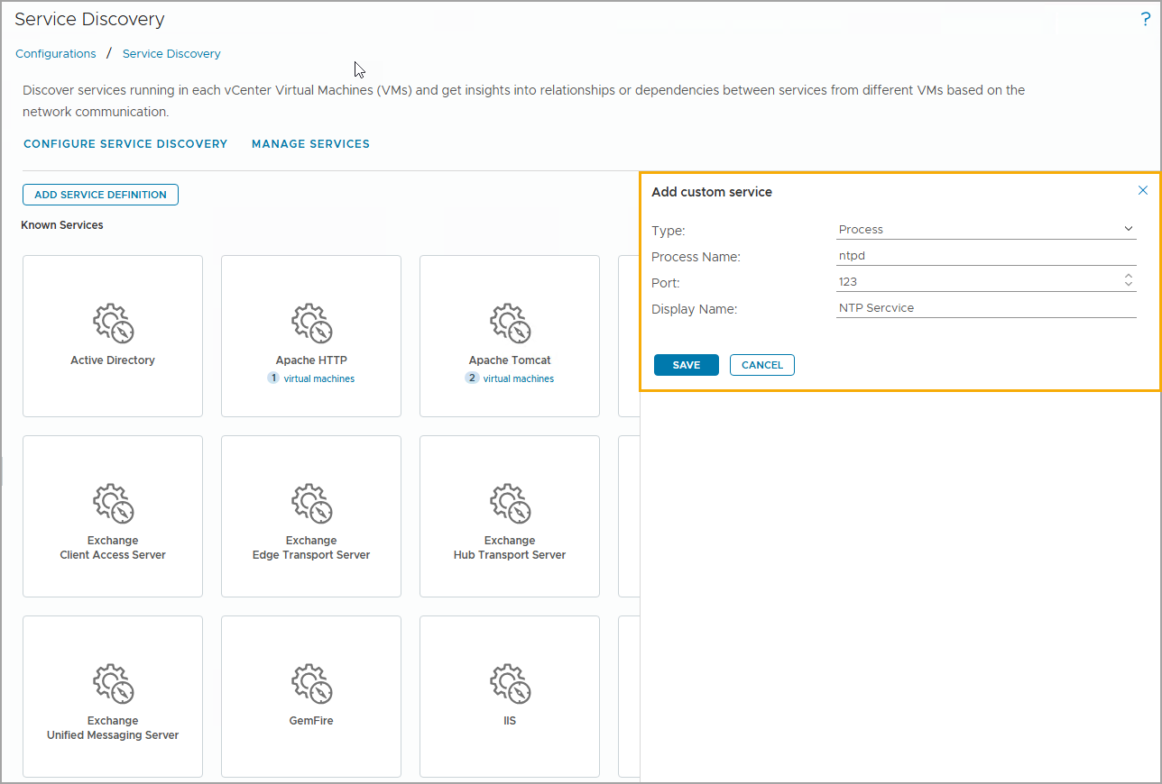
Custom Services Defined by Process Details
When you create a custom service by providing process details, you must specify the process name, a port, and the custom service display name.
Notes:
TalkTrack:
When creating a custom service by providing process details, the process name, a port, and the custom service display name must be specified. The custom service must be listening on a specific port to be discovered.
<End>
The custom service must be listening on a specific port to be discovered.

Slide 21
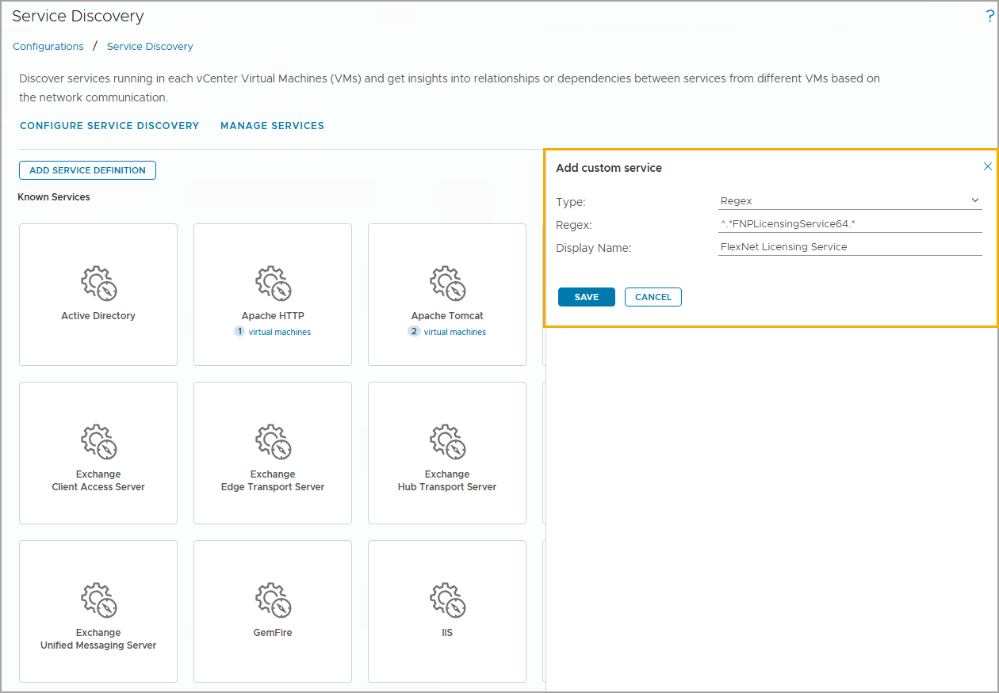
Custom Services Defined by Regular Expression
Custom services defined by a regular expression are a great option in cases where the port bindings might be variable.
When choosing to add a custom service by regular expression, you use the regular expression corresponding to the name of the service that you see in the guest OS when you run the ps command in Linux or the wmic command in Windows.
Notes:
TalkTrack:
Custom services defined by a regular expression are a suitable choice when port bindings might be variable. When adding a custom service via regular expression, use the regular expression corresponding to the service name seen in the guest operating system when running the ps command in Linux or the wmic command in Windows. For example, "cassandra" is a regular expression that can be used to discover Cassandra services.
<End>
For example, cass.*dra is a regular expression that can be used to discover Cassandra services.

Slide 22
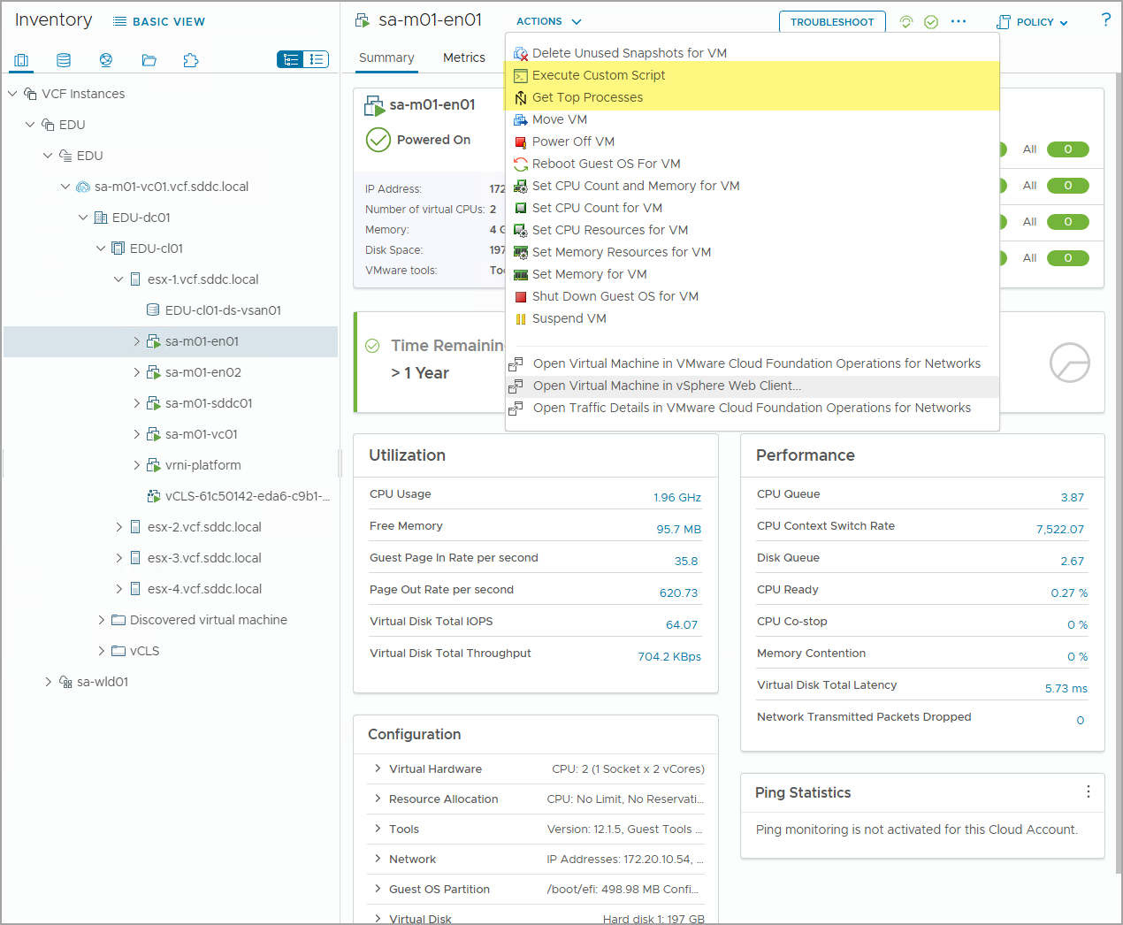
Troubleshooting Actions
Service discovery enables the following additional VM troubleshooting actions:
Execute Custom Script enables you to run a script or a one-time command in the monitored VM's guest OS.
Get Top Processes fetches the top processes from the monitored VM's guest OS.
Notes:
TalkTrack:
Service discovery enables two additional virtual machine troubleshooting actions. One action is to execute a custom script, which allows running a script or a one-time command in the monitored virtual machine's guest operating system. Another action is to get top processes, which fetches the top processes from the monitored virtual machine's guest operating system.
<End>

Slide 23
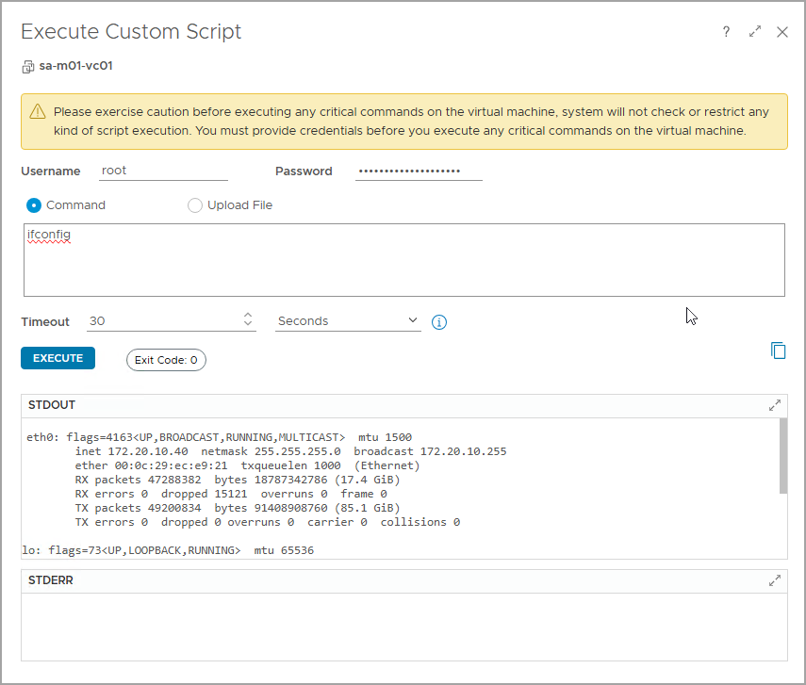
Example: Execute Script Actions
The Execute Script action enables you to run a one-time script or command in a monitored virtual machine.
Execute Script provides the following features:
Runs a script once in the monitored VM's guest OS
Returns STDOUT, STDERR, and exit codes
Variable timeout for long-running scripts
Notes:
TalkTrack:
The Execute Script action allows running a one-time script or command in a monitored virtual machine. This feature provides several capabilities. It can run a script once in the virtual machine's guest operating system. It returns STDOUT, STDERR, and exit codes. There is also a variable timeout for long-running scripts. The Execute Script options require the correct VMware Tools version on the virtual machine and monitoring enabled. For instance, running the ifconfig command on the sa-m01-vc01 virtual machine is an example of this action.
<End>
The Execute Script options require the correct VMware Tools version on the virtual machine and monitoring enabled.
In this example, you are running the ifconfig command against the sa-m01-vc01 VM.

Slide 24
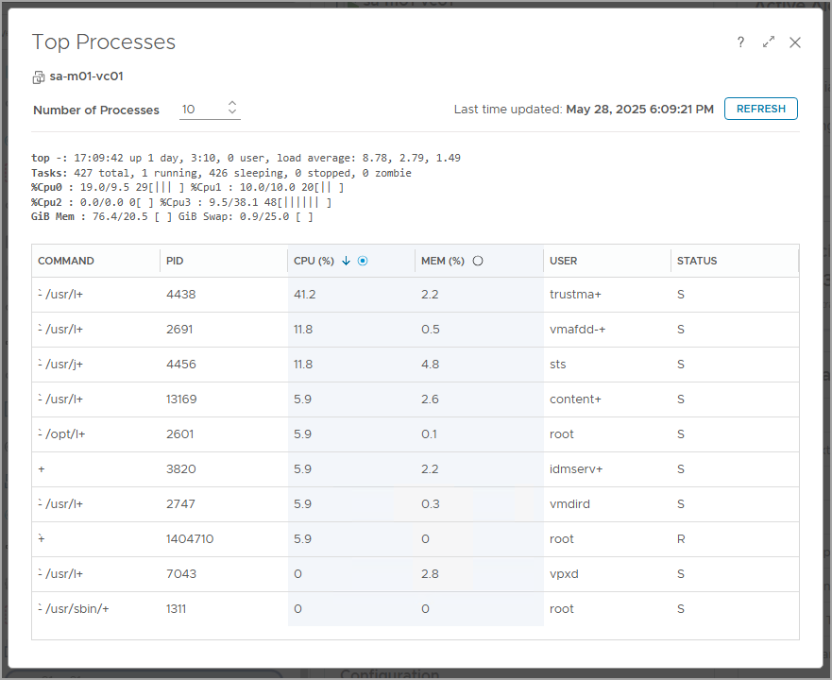
Example: Get Top Processes Actions
Get Top Processes retrieves the top process information such as process status, PID, and owner of the process from a monitored VM guest OS.
Get Top Processes provides the following features:
Fetches top processes from the monitored VM's Windows or Linux guest OS.
Supports Windows and Linux-native process reporting
Shows the limit that you can set on the number of processes
Notes:
TalkTrack:
Get Top Processes retrieves information such as process status, PID, and the owner of the process from a monitored virtual machine's guest operating system. This feature provides several capabilities. It fetches top processes from both Windows and Linux guest operating systems. It also supports native process reporting for both Windows and Linux. Additionally, it shows the limit on the number of processes that can be displayed. The Get Top Processes option requires the correct VMware Tools version on the virtual machine and monitoring to be enabled. One common use case for this action is to find hung processes in the monitored virtual machine's guest operating system.
<End>
The Get Top Processes option requires the correct VMware Tools version on the virtual machine and monitoring enabled. One of the use cases to run the Get Top Processes action is to find the hung process in the monitored VM guest OS.

Slide 25
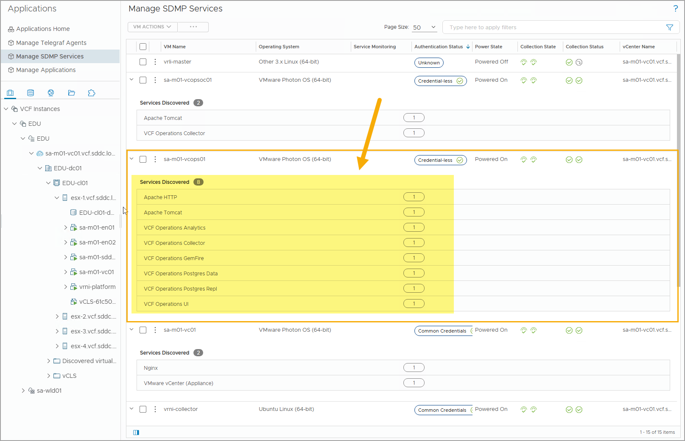
Viewing Discovered Services
To view all discovered services, navigate to Workload Operations > Applications > Manage SDMP Services and expand the VM to view the services discovered from the selected VM.
You can use the following management options:
Access the VM Actions to manage the selected VM.
Activate/deactivate service monitoring for the selected VM.
Provide a password to the selected VM for credential-based service discovery.
Notes:
TalkTrack:
To view all discovered services, navigate to Workload Operations, then Applications, and then Manage SDMP Services. Expand the virtual machine to see its discovered services. Management options are available. Accessing the VM Actions allows management of the selected virtual machine. Service monitoring for the selected virtual machine can be activated or deactivated. A password can also be provided for the selected virtual machine for credential-based service discovery. Service discovery performs searches every 24 hours.
<End>
Service discovery searches for services every 24 hours.

Slide 26
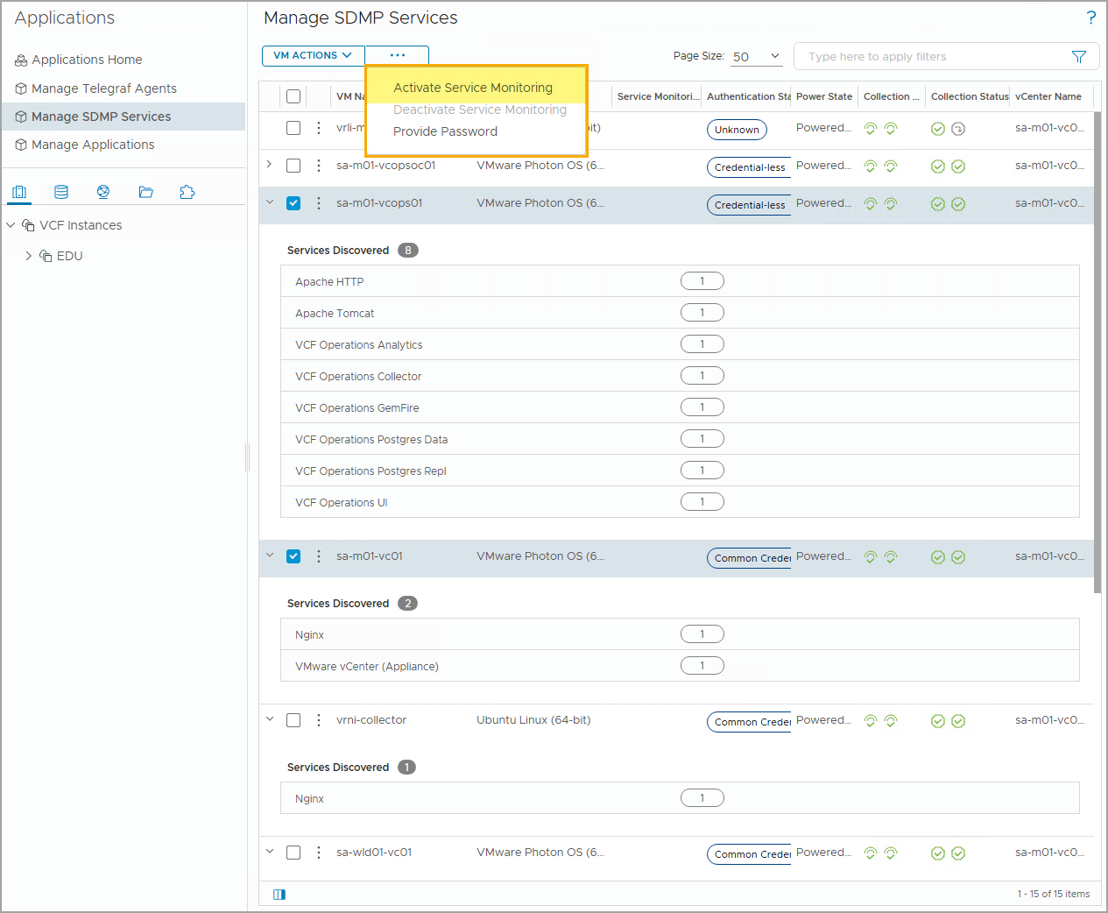
Activating Service Monitoring
Activating Service Monitoring enables the VCF Operations Service Discovery adapter to provide performance and connectivity metrics and properties for the target services with a 5-minute collection cycle.
By default, Service Monitoring is disabled. To activate Service Monitoring, select the target services, click More Options, and select Activate Service Monitoring.
Notes:
TalkTrack:
Activating Service Monitoring enables the VCF Operations Service Discovery adapter to provide performance and connectivity metrics for the target service or services. Data collection occurs on a 5-minute cycle. By default, Service Monitoring is disabled. To activate it, select the target service, click the More Options button, and then select Activate Service Monitoring. Service monitoring can be deactivated to stop frequent service discovery and service performance metrics calculation.
<End>
You can click Deactivate Service Monitoring to disable frequent service discovery and service performance metrics calculation.

Slide 27
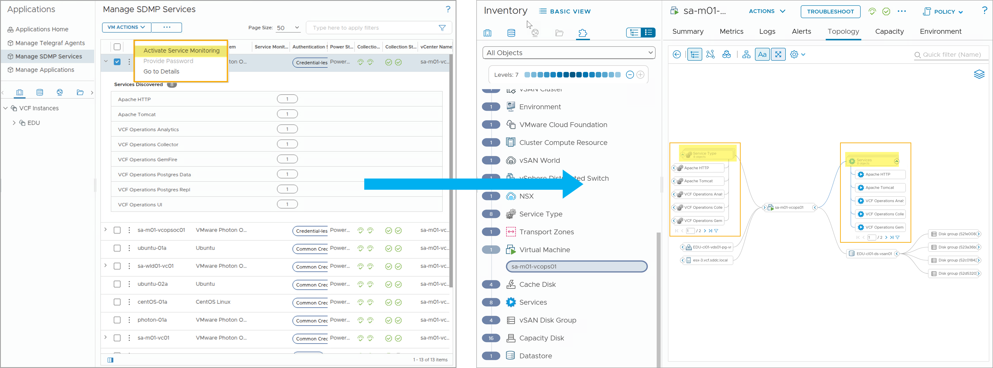
Viewing VM and Services Relationship
When the service monitoring is activated, VCF Operations collects and displays services and service types in the VM topology.
Notes:
TalkTrack:
Once service monitoring is activated, VCF Operations collects and displays service and service types in the virtual machine topology. The screenshot on the left shows enabling service monitoring for the sa-m01-vcops01 virtual machine. The screenshot on the right shows the services and service types collected and displayed on the virtual machine topology.
<End>
In this example:
The screenshot on the left shows enabling service monitoring for the sa-m01-scops01 VM.
The screenshot on the right shows the services and service types are collected and displayed on the VM topology.

Slide 28
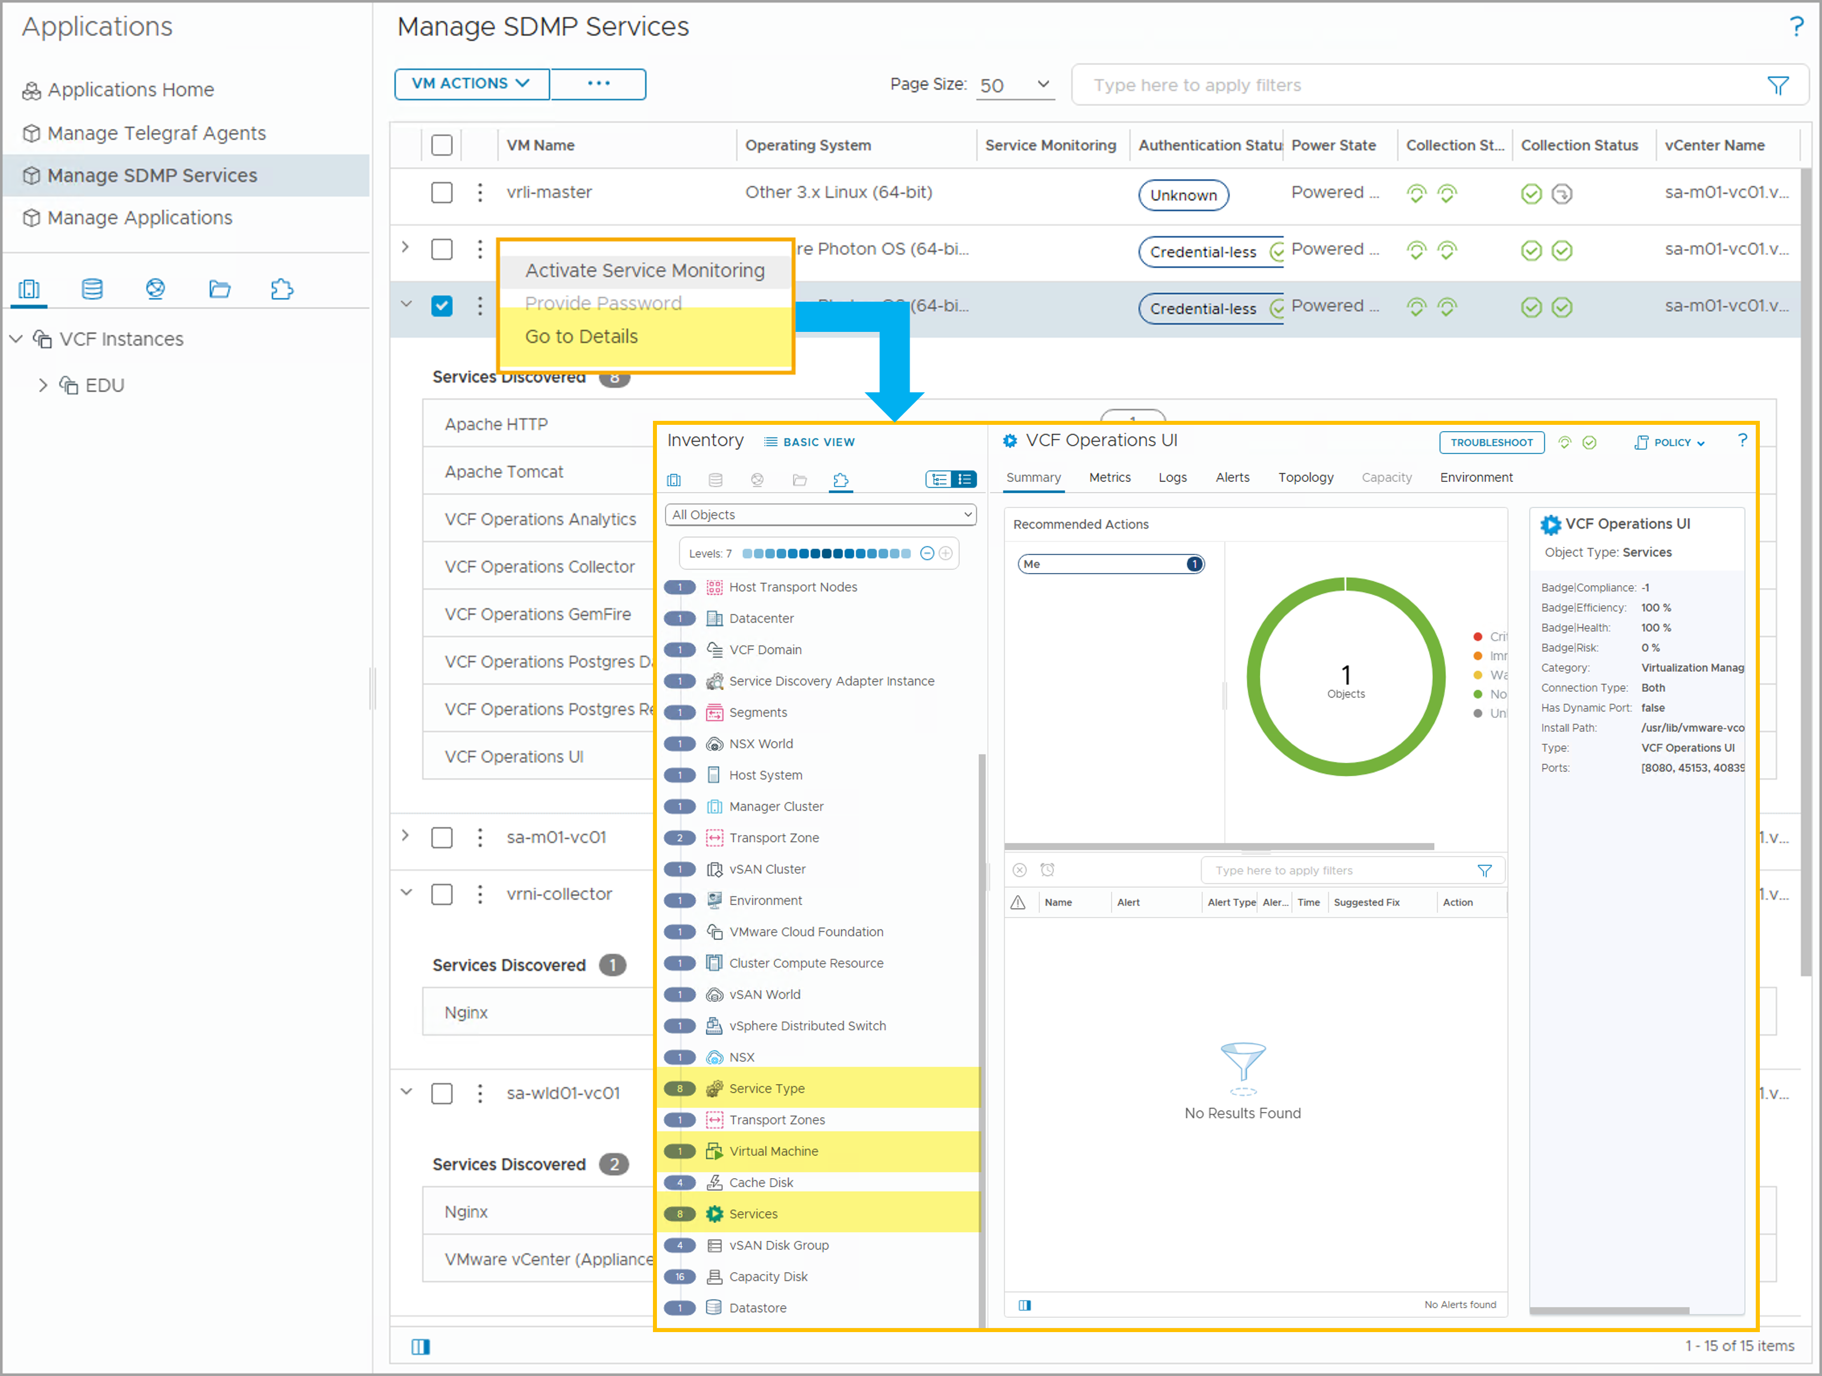
Understanding Service Discovery Metrics
When Service Discovery is activated, VCF Operations discovers and collects service-related metrics from the eligible VMs, including:
Virtual Machine metrics
Service Summary metrics
Service Performance metrics
Service Type metrics
It also discovers CPU and memory metrics for discovered services.
Notes:
TalkTrack:
When service discovery is activated, VCF Operations discovers and collects service-related metrics from eligible virtual machines. These include virtual machine metrics, service summary metrics, service performance metrics, and service type metrics. VCF Operations also discovers CPU and memory metrics for discovered services.
<End>

Slide 29
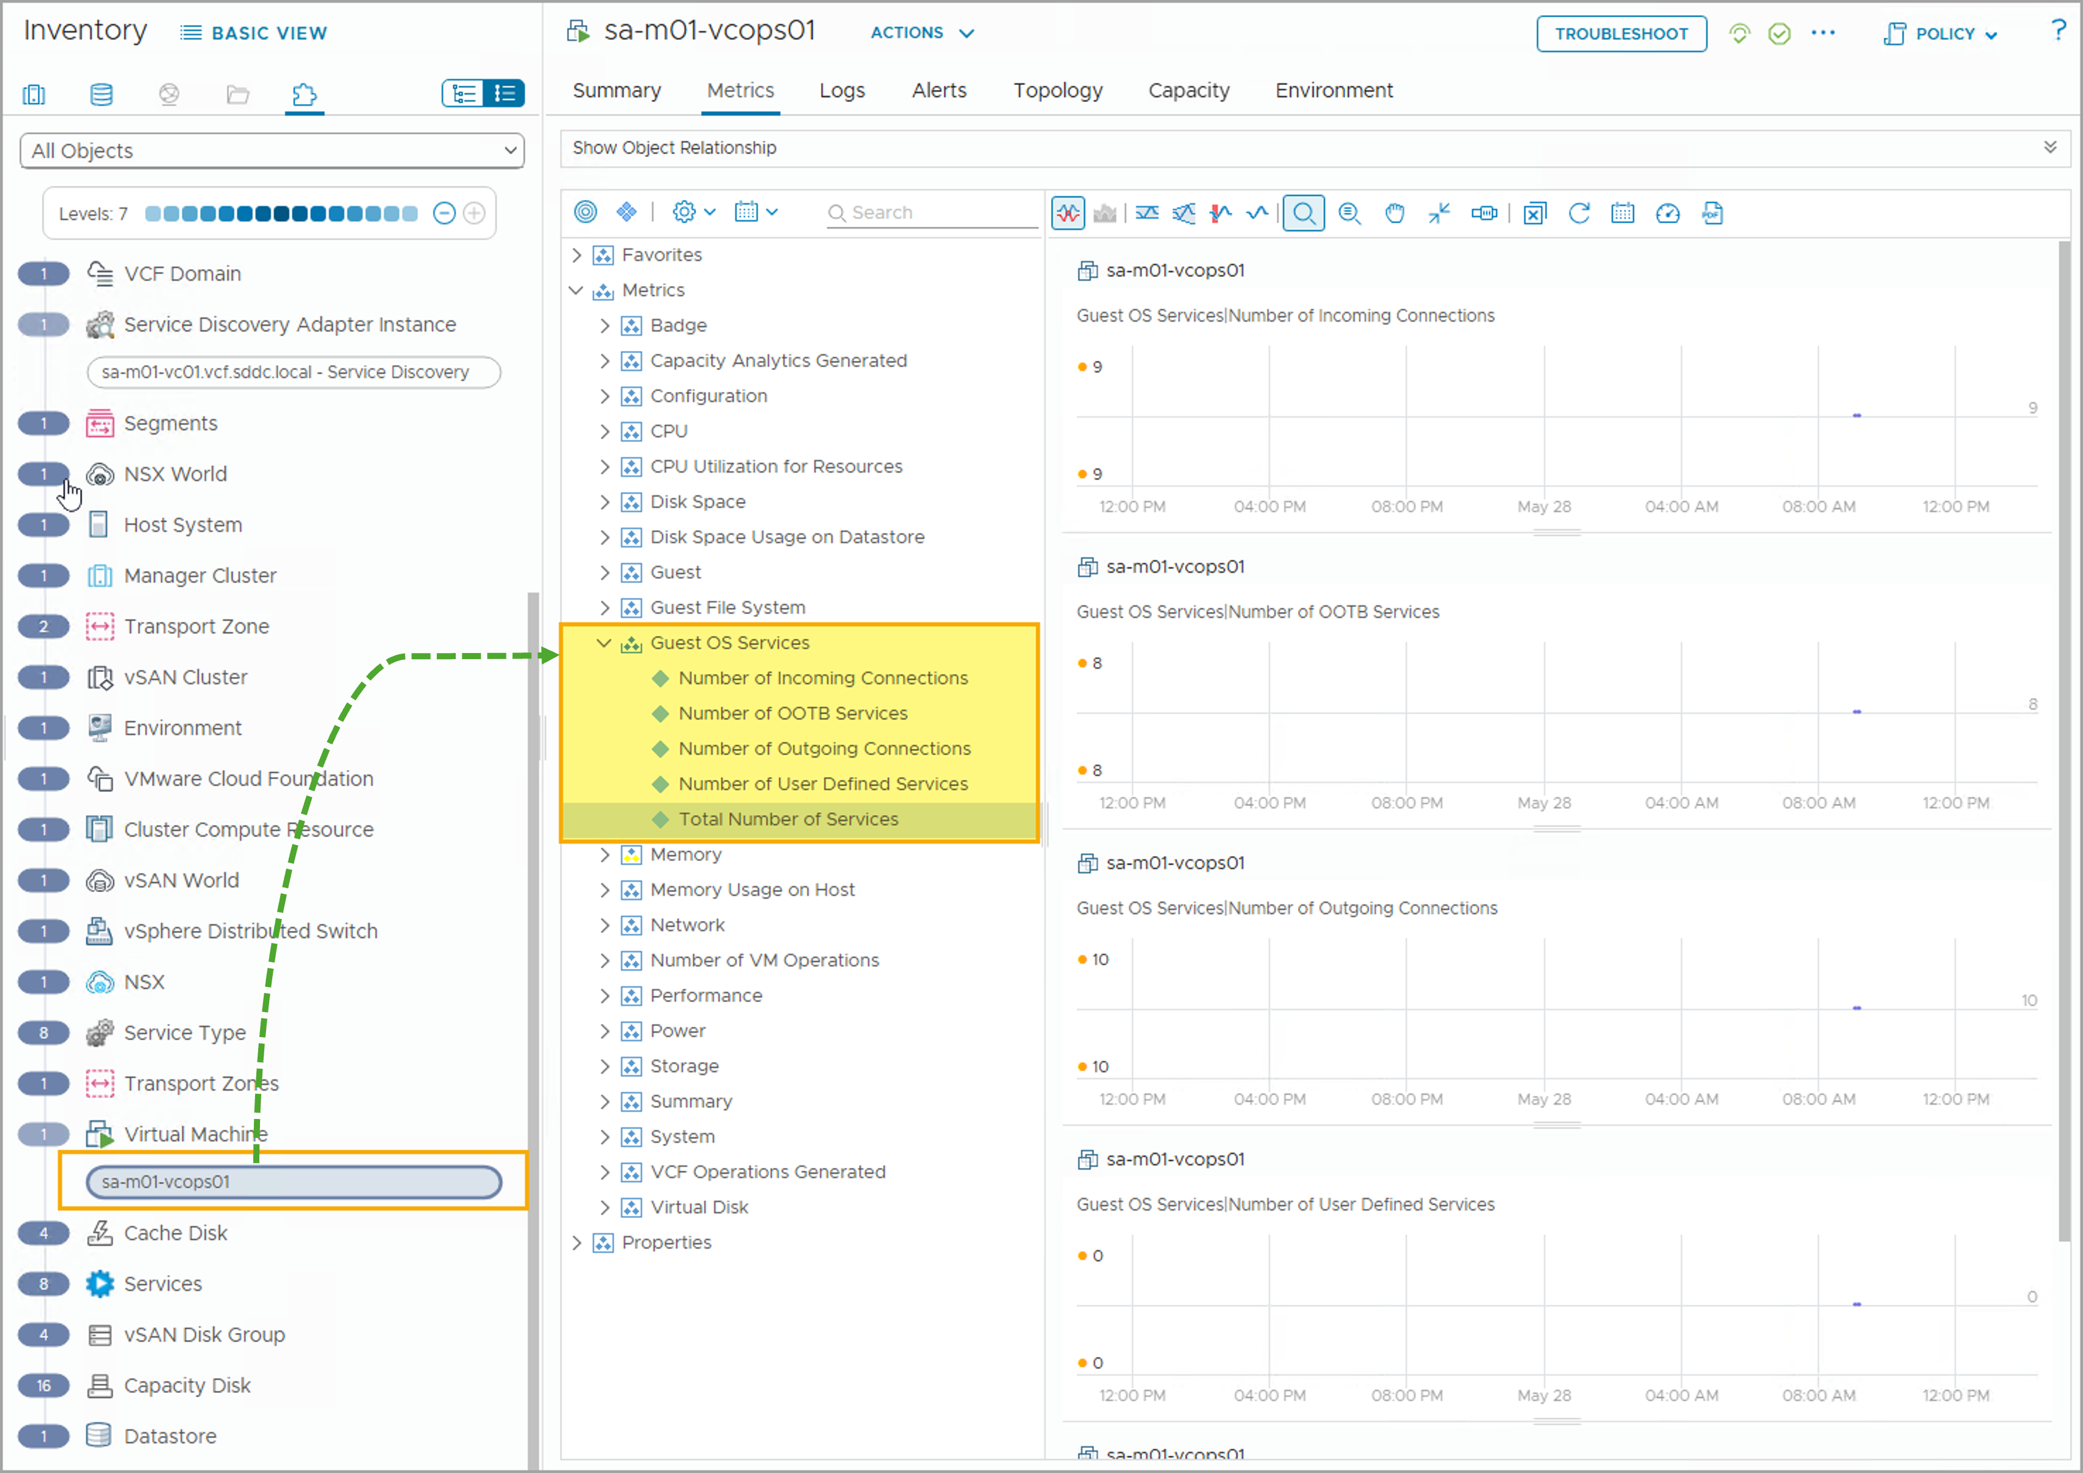
Virtual Machine Metrics
Service Discovery discovers the following Guest OS Services metrics for virtual machines:
Total Number of Services
Number of User Defined Services
Number of OOTB Services
Number of Outgoing Connections
Number of Incoming Connections
Notes:
TalkTrack:
Service discovery uncovers several Guest OS Service metrics for virtual machines. These include the total number of services, the number of user-defined services, the number of out-of-the-box services, the number of outgoing connections, and the number of incoming connections. Guest OS Services Total Number of Services refers to the combined count of out-of-the-box and user-defined services discovered within the virtual machine. Guest OS Services User Defined Services represents the count of user-defined services discovered in the virtual machine. Guest OS Services Number of OOTB Services indicates the count of out-of-the-box services discovered in the virtual machine. Guest OS Services Number of Outgoing Connections refers to the outgoing connection counts from the discovered services. Guest OS Services Number of Incoming Connections indicates the incoming connection counts to the discovered services.
<End>
Metric descriptions:
Guest OS Services|Total Number of Services: Number of out-of-the-box and user-defined services discovered in the VM.
Guest OS Services|Number of User Defined Services: Number of user-defined services discovered in the VM.
Guest OS Services|Number of OOTB Services: Number of out-of-the-box services discovered in the VM.
Guest OS Services|Number of Outgoing Connections: Number of outgoing connection counts from the discovered services.
Guest OS Services|Number of Incoming Connections: Number of incoming connection counts to the discovered services.

Slide 30
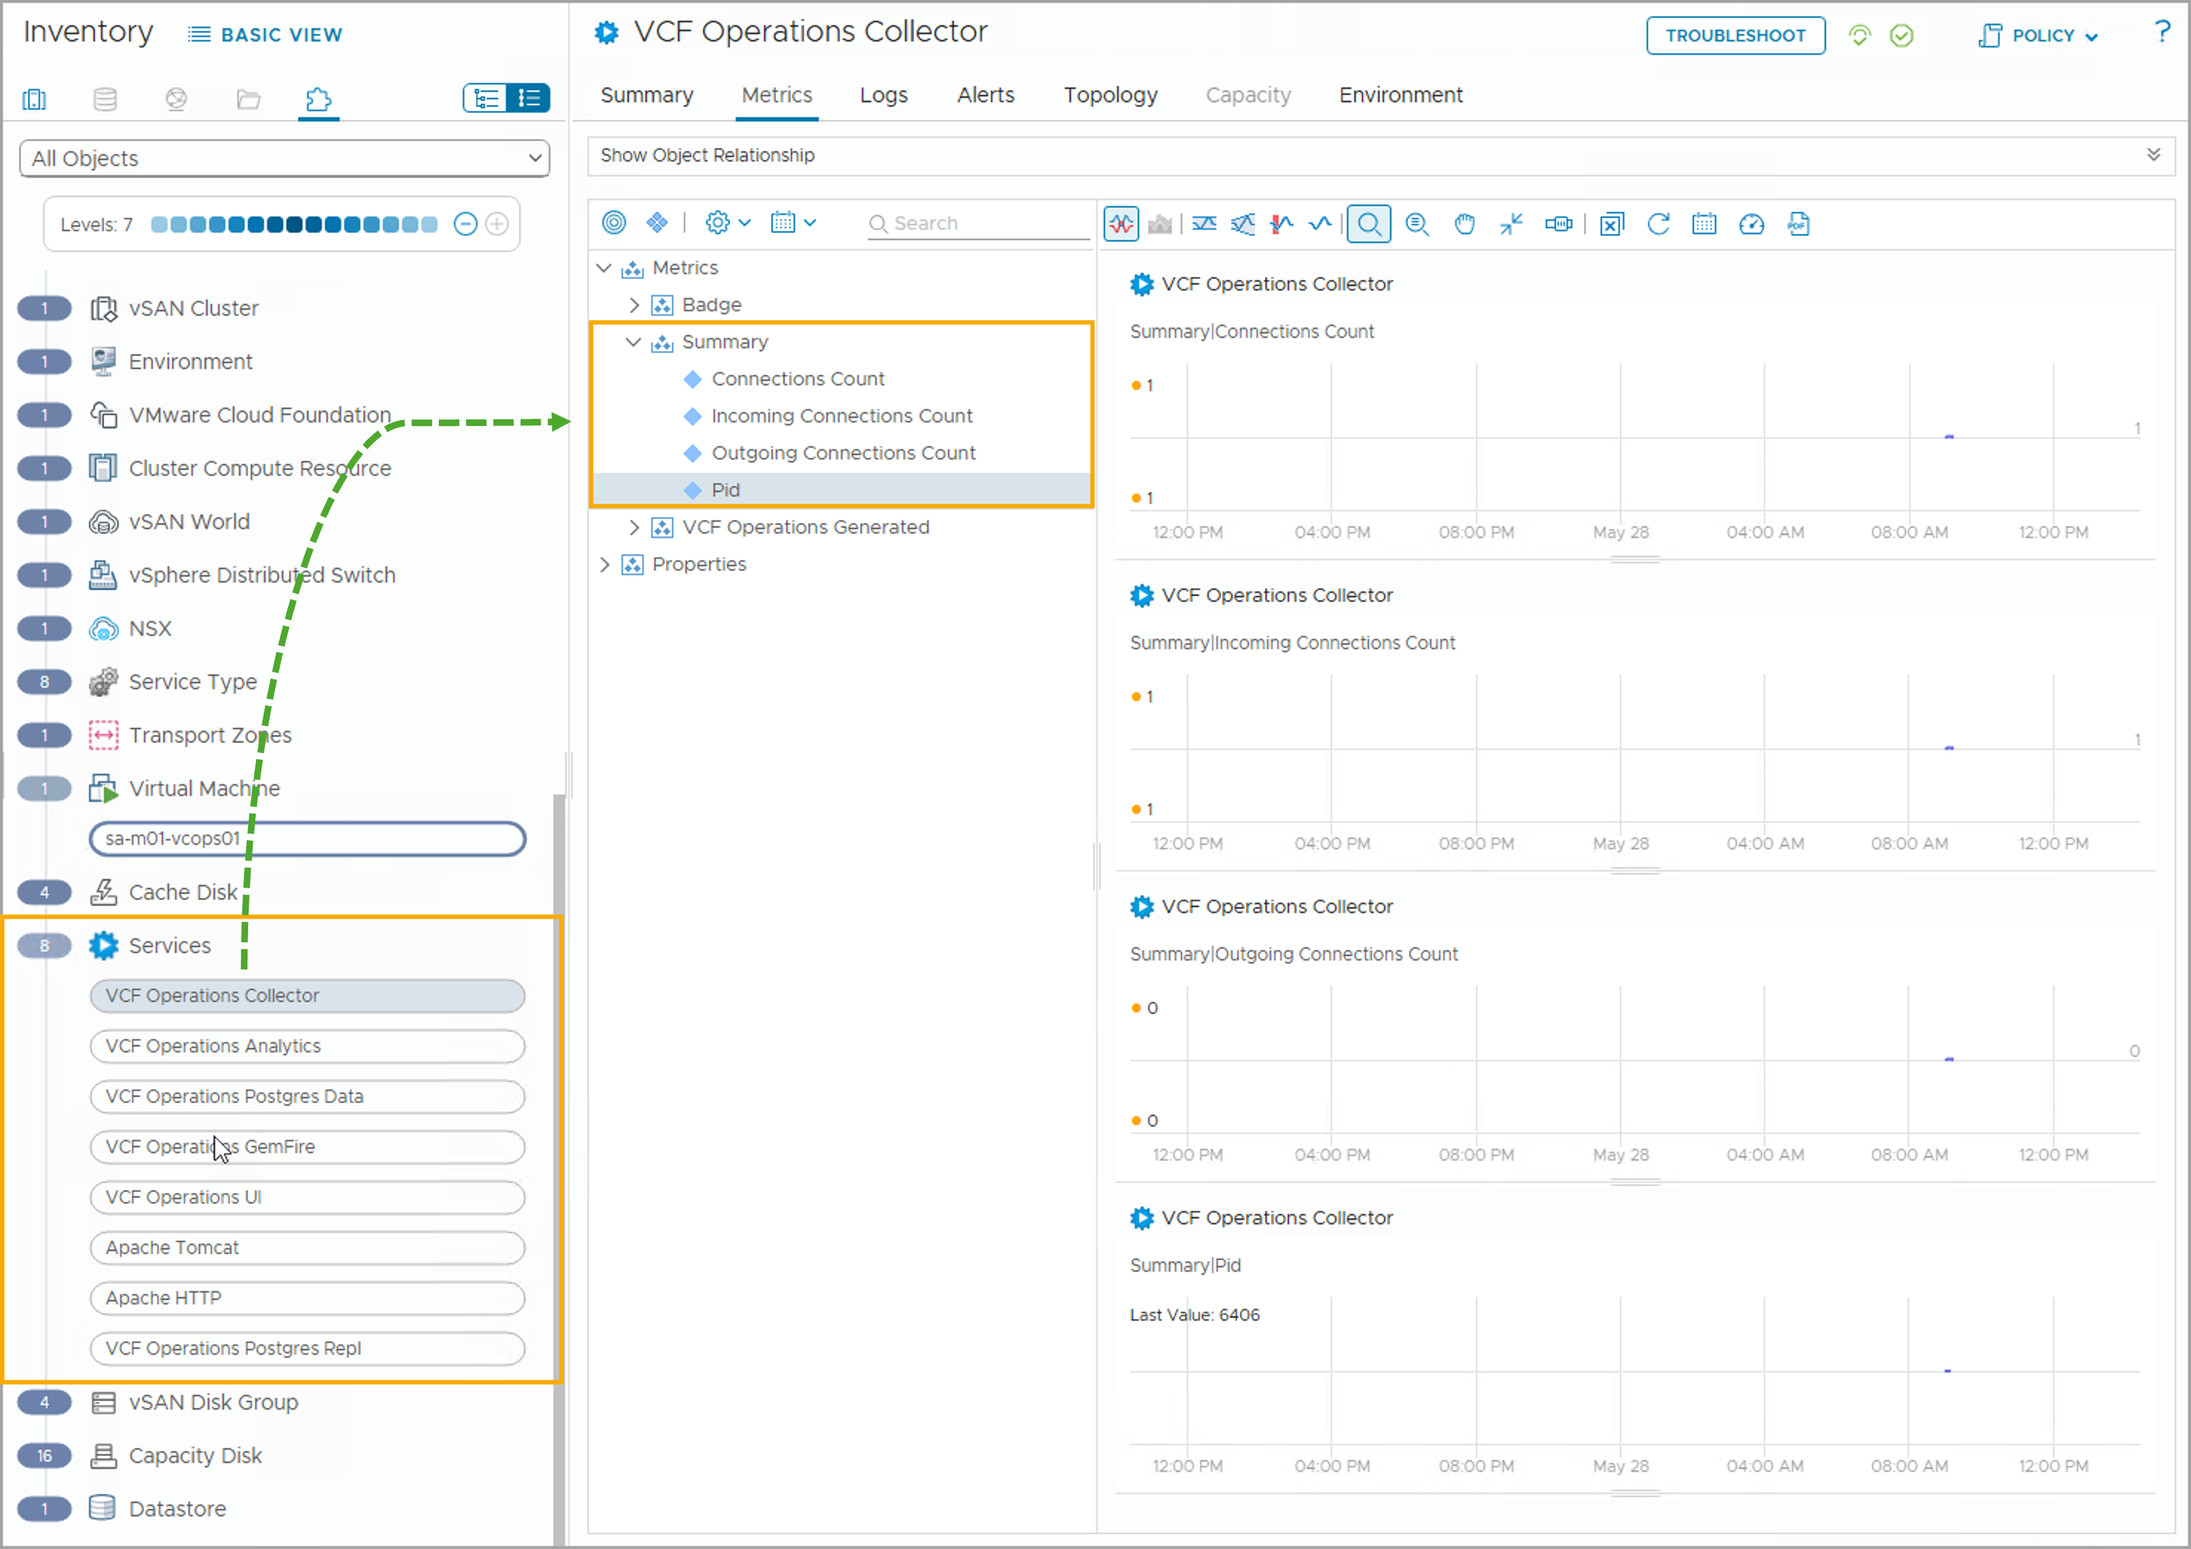
Service Summary Metrics
Service Discovery discovers the following additional Summary metrics for virtual machines:
Incoming Connections Count: Number of incoming connections.
Outgoing Connections Count: Number of outgoing connections.
Connections Count: Number of incoming and outgoing connections.
Pid: Process ID.
Notes:
TalkTrack:
Service Discovery provides additional summary metrics for virtual machines. These include the incoming connections count, which is the number of incoming connections. The outgoing connections count represents the number of outgoing connections. The total connections count is the number of incoming and outgoing connections combined. Lastly, the PID represents the process ID.
<End>

Slide 31
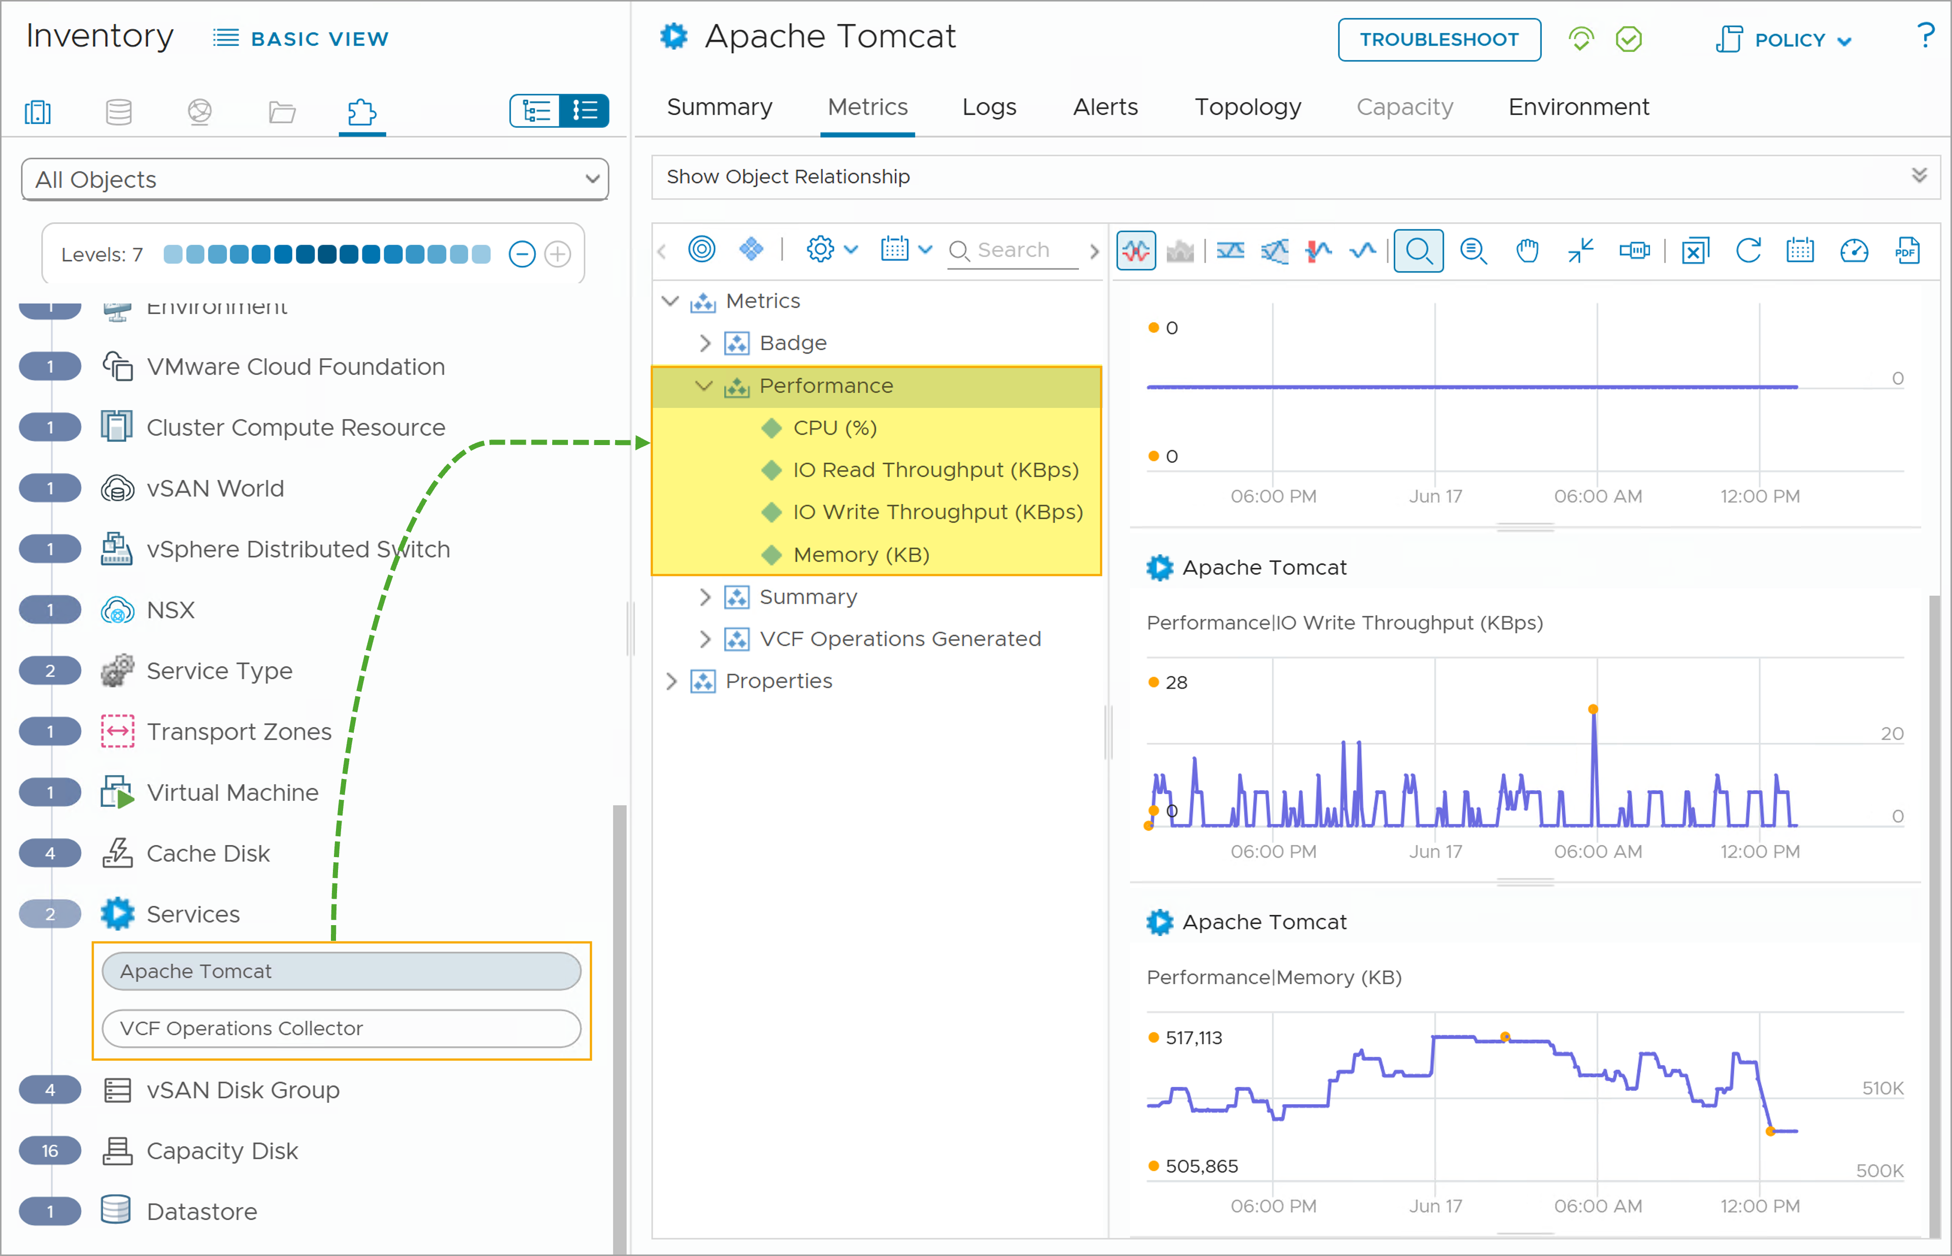
Service Performance Metrics
Service Discovery discovers the following additional performance metrics for the services discovered from the target virtual machines:
CPU: CPU usage in percentage.
Memory: Memory usage in KB.
IO Read Throughput: I/O read throughput in KBps.
IO Write Throughput: I/O write throughput in KBps.
Notes:
TalkTrack:
Service Discovery provides additional performance metrics for services found on target virtual machines. These metrics include CPU usage, measured in percentage. Memory usage is another metric, recorded in KB. IO Read Throughput is measured in KBps, indicating the rate of data read operations. Similarly, IO Write Throughput is also measured in KBps, showing the rate of data write operations.
<End>

Slide 32
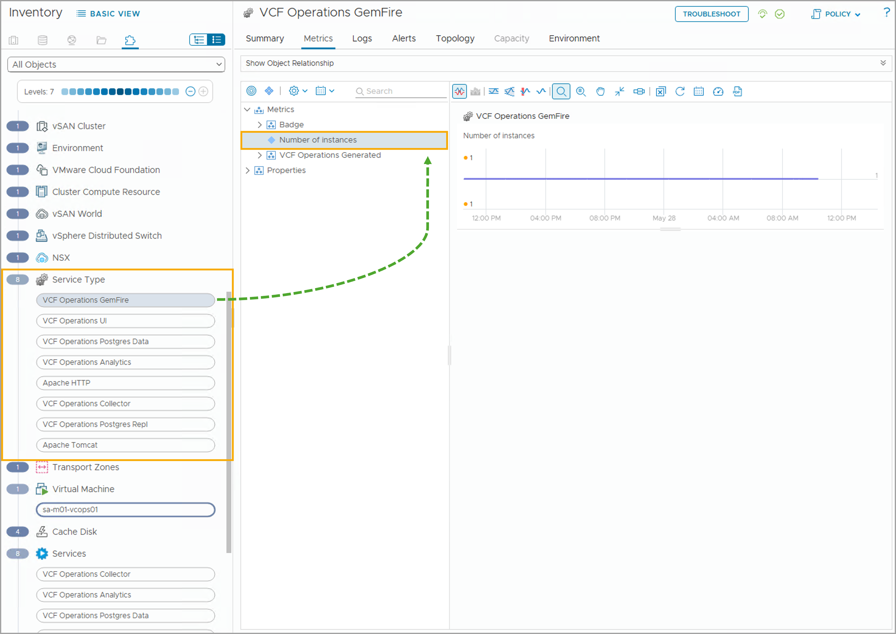
Service Type Metrics
Service Discovery can discover a Service Type metric called Number of Instances. This metric records the number of instances of this service type.
Notes:
TalkTrack:
Service Discovery can uncover a Service Type metric, which is the Number of Instances. This metric records how many instances of a particular service type exist.
<End>

Slide 33
Lab: Configuring Service Discovery
Configure and use the Service Discovery feature to monitor services:
Configure Service Discovery
Add a Custom Service for Discovery
Activate Service Monitoring

Slide 34
Review of Learner Objectives
Enable service discovery for a VCF deployment
Perform actions enabled by the native service discovery
Enable service monitoring
Describe the different types of service metrics
Use collected metrics to interpret the status of services

Slide 35
Application Monitoring

Slide 36
Learner Objectives
Install Telegraf agents to target VMs
Enable application service monitoring
Describe the different types of application metrics
Examine OS and application status from collected metrics

Slide 37
Steps to Monitor Applications
To monitor applications with VCF Operations, you must complete the prerequisites and Telegraf agent installation.
Notes:
TalkTrack:
To monitor applications with VCF Operations, the prerequisites must be completed, and the Telegraf agent installed. First, ensure at least one cloud proxy is configured. Next, ensure a vCenter instance and account are configured in VCF Operations. After that, confirm all other prerequisites have been met. Then, enable service discovery and application monitoring. This involves installing the Telegraf agent on selected target machines. It also involves enabling Service Discovery for a domain. Finally, activate application services on Telegraf agent-running virtual machines, or activate service monitoring on Service Discovery-enabled virtual machines. Then, view the summary of application services and operating systems discovered in VCF Operations.
<End>
Ensure at least one cloud proxy is configured.
Ensure a vCenter instance and account is configured in VCF Operations.
Ensure the prerequisites have been met.
Enable service discovery and application monitoring:
Install Telegraf agent on selected target machine(s).
Enable Service Discovery for a domain.
Activate application service(s) on Telegraf agent-running VM(s) / Activate service monitoring on Service Discovery-enabled VM(s).
View the summary of application services and operating systems discovered in VCF Operations.

Slide 38
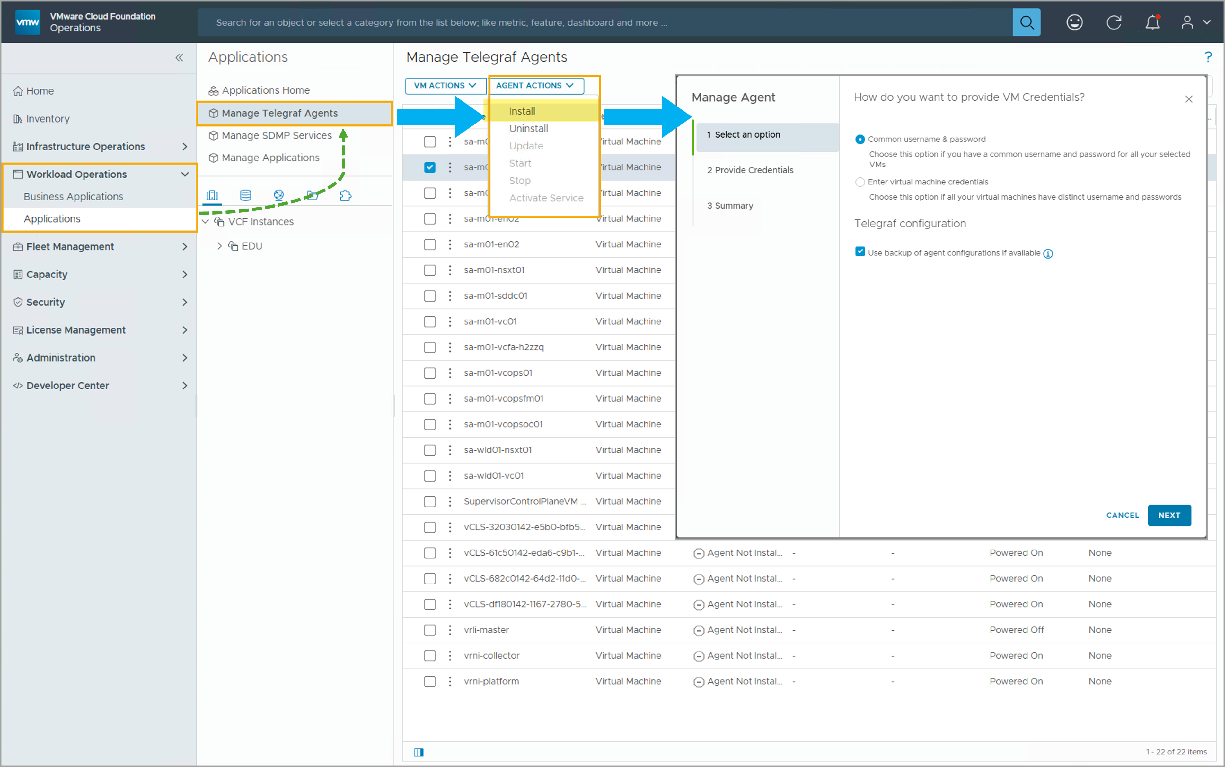
Installing Telegraf Agents for VMs
To install the Telegraf agent:
Select the cloud proxy (without HA) or cloud proxy group (with HA).
Provide the install credentials.
You can either use a common user name and password for all selected VMs or choose to provide distinct user names and passwords for each VM.
Complete the Telegraf agent installation.
Notes:
TalkTrack:
Telegraf agents can be installed on virtual machines. This process requires selecting a target virtual machine or a custom group of virtual machines. An associated user account credential must also be provided. The agent installation is then deployed to the virtual machine. When installing a Telegraf agent, ensure the target virtual machines are reachable. Communication between the cloud proxy and target virtual machines is necessary. Target machines must be accessible via IP and FQDN on port 443, using HTTPS. Target machines must also be able to reach ports 443, 4505, and 4506 on the cloud proxy or the virtual IP of the application monitoring high availability activated collector group. If deploying to a highly available collector group, ensure the cloud proxies are functioning properly. The Cloud Proxy appliance should be deployed in the same vCenter instance as the virtual machines to be monitored. Multiple cloud proxies can be deployed. Verify that the prerequisites for user permissions and network communications are met. This includes the ESX instance hosting the virtual machines having HTTPS/443 access to the collector node where the service discovery adapter instance is configured. The system clocks of the VCF Operations nodes, vCenter, and virtual machines must be synchronized. Required commands and utilities must be enabled on target virtual machines. For credential-based service discovery, user permissions must be correctly configured. After successful installation, the Telegraf agent collects metrics from the virtual machine. These metrics are displayed in VCF Operations.
<End>
To collect OS and application services from a target VM, the Telegraf agent must be installed on the target VM. To install Telegraf agent, navigate to Workload Operations > Applications > Manage Telegraf Agents, then select the target VM(s) and select Agent Actions > Install.
In your environment, you may have multiple cloud proxies and may use multiple cloud proxies for high availability, this setup is called a Collector Group (or sometimes Cloud Proxy group). When high availability is enabled for a collector group, in case a member is down, the other member(s) of the high availability group will continue to monitor. To configure a cloud proxy group for high availability, navigate to Administrations > Cloud Proxies > Collector Groups, and click Add. You need to select the Activate for High-Availability, enter a Virtual IP for this collector group, and select the group members (cloud proxies).
In the Telegraf agent installation wizard, you will be prompted to select a cloud proxy or a cloud proxy (collector) group:
Cloud Proxy Groups, with High-Availability: choose the Collector Group you would like to use for Telegraf agent connections.
Cloud Proxies, without High-Availability: choose a single cloud proxy for Telegraf agent connections.
Alternatively, you can install Telegraf agents on VMs using scripts. For detailed instructions, please see the following technical documentations:
For Linux: https://techdocs.broadcom.com/us/en/vmware-cis/vcf/vcf-9-0-and-later/9-0/workload-monitoring-and-observability/os-and-application-monitoring/steps-to-monitor-your-applications/install-and-uninstall-an-agent/install-uninstall-an-agent-using-a-script-on-linux-platforms-onprem.html
For Windows: https://techdocs.broadcom.com/us/en/vmware-cis/vcf/vcf-9-0-and-later/9-0/workload-monitoring-and-observability/os-and-application-monitoring/steps-to-monitor-your-applications/install-and-uninstall-an-agent/install-uninstall-an-agent-using-a-script-on-windows-platforms-onprem.html

Slide 39
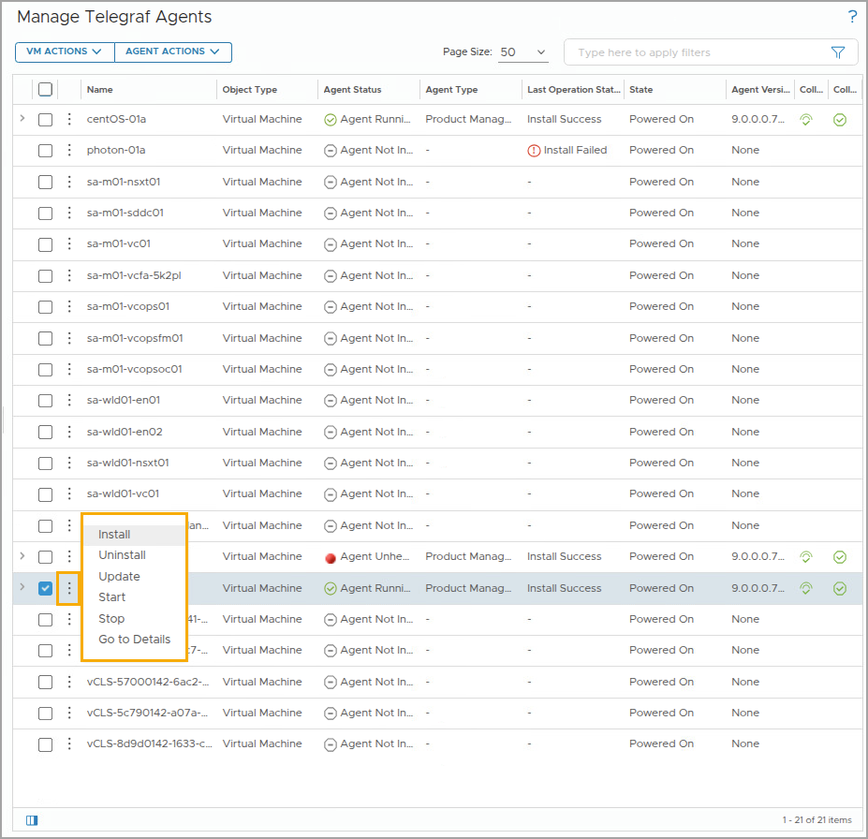
Managing Telegraf Agents on VMs
To view the available agent management options, first select a Telegraf agent-installed VM and click either Agent Actions or the vertical ellipsis icon.
You can perform the following additional management actions:
Install
Uninstall
Update
Stop
Start
Additionally, you can use the Filter options to only view VMs that meet your defined criteria.
Notes:
TalkTrack:
To view available agent management options, first select a Telegraf agent-installed virtual machine, then click Agent Actions or the vertical ellipsis. Additional management actions include installing, uninstalling, updating, stopping, and starting agents. The filter options can be used to view only virtual machines that meet defined criteria. Uninstalling removes the Telegraf agent from the selected virtual machine. Updating upgrades the Telegraf agent on the selected virtual machine to a newer version. Stopping temporarily suspends sending application service metrics to VCF Operations, which can be useful during maintenance. Starting resumes sending application service metrics to VCF Operations. Activating service initiates application service monitoring and metric sending for discovered application services.
<End>
Uninstall: to uninstall Telegraf agent from the selected VM.
Update: to update the Telegraf agent on the selected VM to a higher version.
Stop: to stop sending application service metrics to VCF Operations.
For example, during the maintenance window, you can use Stop to temporarily stop metric sending.
Start: to restart sending application service metrics to VCF Operations.
Activate Service: to activate application service monitoring and metric sending for discovered application service(s).

Slide 40
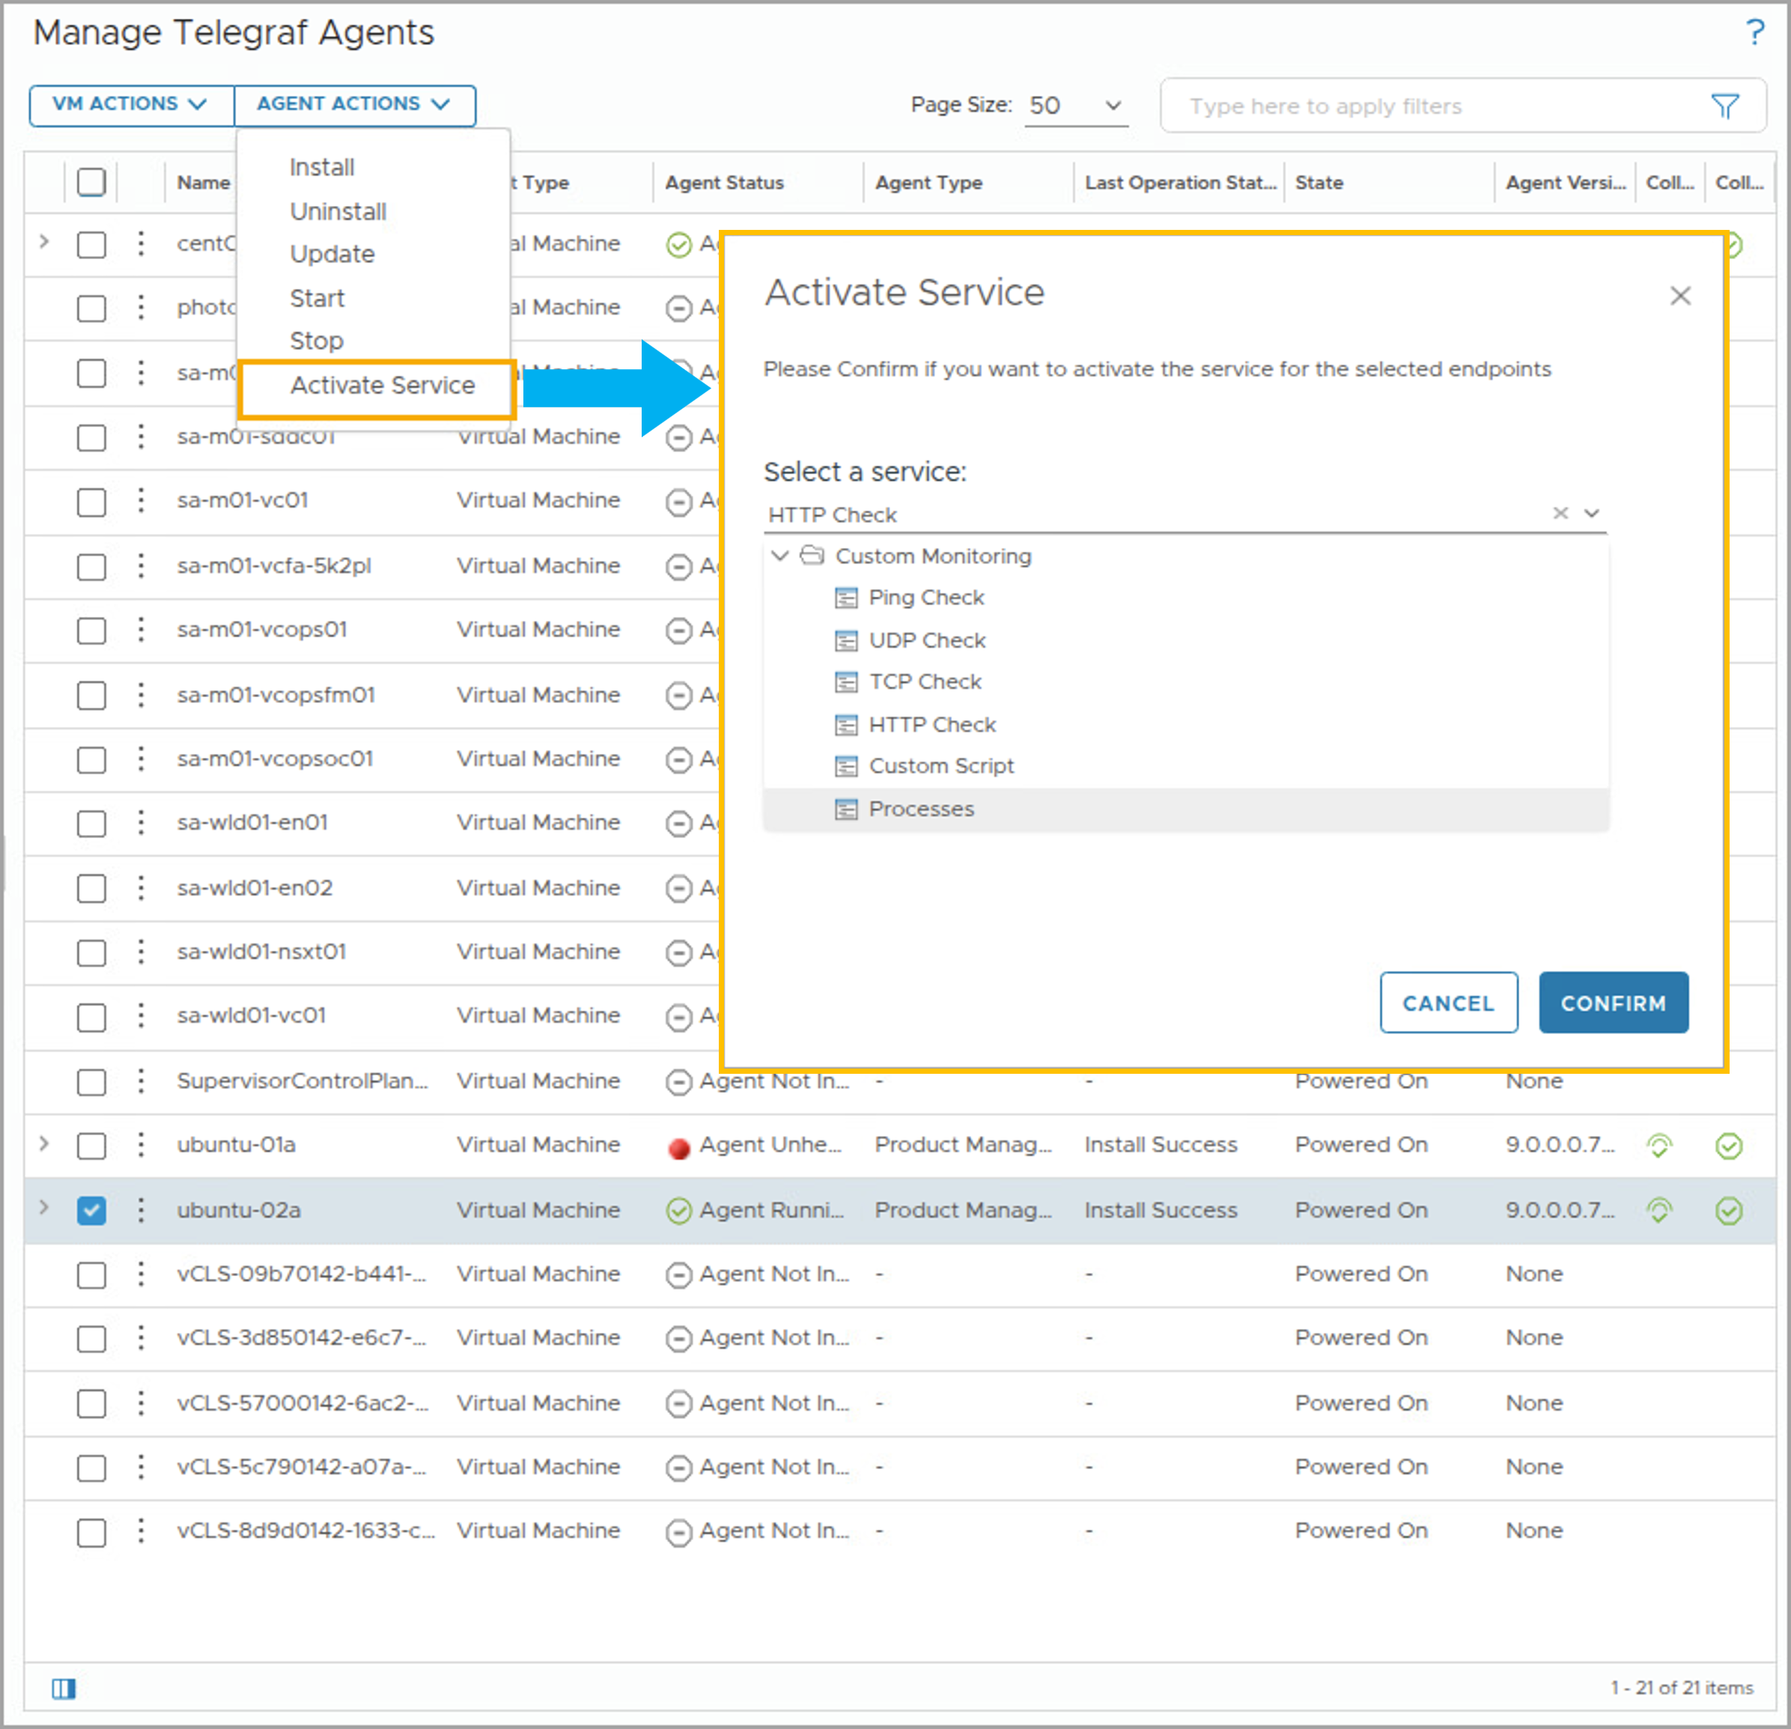
Activating an Application Service
After successfully installing the Telegraf agent on a target VM, you can activate plug-ins to monitor application services on Telegraf agent-installed VMs. To activate application service monitoring:
Add a Filter by Agent Status > Agent Running to only view the VMs where Telegraf agents are installed and running.
Select a Telegraf agent-installed VM, click Agent Actions, and select Activate Service.
Select the service to monitor and click Confirm.
Notes:
TalkTrack:
After successfully installing the Telegraf agent on a target virtual machine, plugins can be activated to monitor application services on Telegraf agent-installed virtual machines. To activate application service monitoring, filter by Agent Status and select "Agent Running" to view only virtual machines with active Telegraf agents. Next, select a Telegraf agent-installed virtual machine, click Agent Actions, and then select Activate Service. Finally, select the service to monitor and click Confirm. The Manage Telegraf Agents page allows for various remote checks, including Ping Check, UDP Check, TCP Check, and HTTP Check. Custom Monitoring encompasses all these, plus Custom Script and Processes. Activating service enables service monitoring for one or more services.
<End>
On the Manage Telegraf Agents page, you can add remote checks to a Telegraf agent-installed VM and monitor the remote check results.
Remote Check includes Ping Check, UDP Check, TCP Check, and HTTP Check. Custom Monitoring includes everything in Remote Check, plus Custom Script and Processes.
Activating service in this context means adding a service monitoring for one or more of these services.

Slide 41
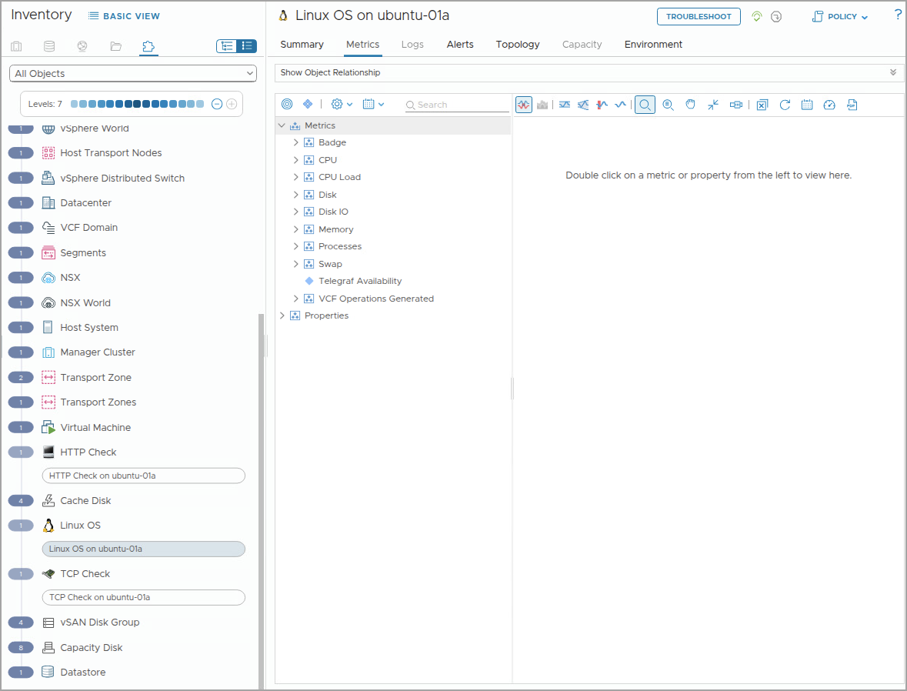
Understanding Applications Metric Collection
With the OS and Application Monitoring capability, VCF Operations can collect the following types of metrics from the target VMs:
Operation System metrics: Are collected for Linux and Windows operating systems.
Application Service metrics: Are collected for 23 application services to help understand the application performance and runtime status.
Remote Check metrics: Are collected for object types such as HTTP, ICMP, TCP, and UDP.
Linux Process metrics: Are collected for Linux services.
Windows Service metrics: Are collected for Windows services.
Notes:
TalkTrack:
With OS and Application Monitoring capabilities, VCF Operations can collect several types of metrics from target virtual machines. Operation System metrics are gathered for both Linux and Windows operating systems. Application Service metrics are collected for 23 application services to help understand application performance and runtime status. Remote check metrics are collected for object types such as HTTP, ICMP, TCP, and UDP. Linux Process metrics are collected for Linux services, and Windows Service metrics are collected for Windows services.
<End>

Slide 42
Operating System Metrics
VCF Operations can collect additional metrics on the operating system level from Telegraf agent-installed VMs.
The following metrics are collected for Linux operating systems:
<instance name> | Usage Guest (%)
<instance name> | Usage Active (%)
<instance name> | Read Time
<instance name> | Write Time
<instance name> | Disk Used (%)
Running (Processes)
Telegraf Availability
The following metrics are collected for Windows operating systems:
Usage Guest
Usage System
Disk Read Time
Disk Write Time
IO Read Bytes persec
IO Write Bytes persec
Telegraf Availability
Notes:
TalkTrack:
VCF Operations collects additional metrics at the operating system level from Telegraf agent-installed virtual machines. For Linux operating systems, metrics include instance name and guest usage percentage, instance name and usage active percentage, instance name and read time, instance name and write time, and instance name and disk used percentage. Running processes and Telegraf availability are also collected. For Windows operating systems, collected metrics include guest usage, usage system, disk read time, disk write time, IO read bytes per second, IO write bytes per second, and Telegraf availability.
<End>
For a complete list of Operating System metrics collected by VCF Operations and Telegraf agent, please see the technical documentation at https://techdocs.broadcom.com/us/en/vmware-cis/vcf/vcf-9-0-and-later/9-0/infrastructure-operations/metric-property-and-alert-definitions/metrics-definitions-in-vrealize-operations-manager/os-and-application-monitoring-metrics/operating-system-metrics.html.

Slide 43
Application Service Metrics
VCF Operations can collect metrics for the following application services:
Active Directory
ActiveMQ
Apache HTTPD
Apache Tomcat
Microsoft IIS
Java Application
JBoss Server
HyperV
Oracle DB
Cassandra
MongoDB
MS Exchange
Microsoft SQL Server
MySQL
NGINX
Network Time Protocol
Oracle WebLogic Server
Pivotal TC Server
PostgreSQL
RabbitMQ
Riak KV
SharePoint
WebSphere
Notes:
TalkTrack:
VCF Operations collects metrics for various application services. These include Active Directory, ActiveMQ, Apache HTTPD, Apache Tomcat, and Microsoft IIS. Other services are Java Application, JBoss Server, HyperV, Oracle DB, Cassandra, and MongoDB. Furthermore, metrics are collected for MS Exchange, Microsoft SQL Server, MySQL, NGINX, Network Time Protocol, Oracle WebLogic Server, Pivotal TC Server, PostgreSQL, RabbitMQ, Riak KV, SharePoint, and WebSphere.
<End>

Slide 44
Remote Check Metrics
VCF Operations can collect the following Remote Check metrics:
HTTP Metrics:
Availability
Content Length
Response Code
Response Time
Result Code
TCP Metrics:
Availability
Result Code
Response Time
ICMP Metrics:
Availability
Average Response Time
Packet Loss (%)
Packets Received
Packets Transmitted
Result Code
UDP Metrics:
Availability
Response Time
Result Code
Notes:
TalkTrack:
VCF Operations can gather various Remote Check metrics. For HTTP Metrics, collected data includes availability, content length, response code, response time, and result code. TCP Metrics encompass availability, response time, and result code. ICMP Metrics provide availability, average response time, packet loss percentage, packets received, packets transmitted, and result code. UDP Metrics include availability, response time, and result code.
<End>

Slide 45
Linux Process and Windows Service Metrics
VCF Operations can collect several Linux processes and Windows service metrics.
Metric Name | Category | KPI
Linux
Availability | Resource Availability | Processes | False
Utilization | Memory Usage (%) | Processes | False
Utilization | CPU Usage (%) | Processes | False
Utilization | Number of Processes | Processes | False
Windows
Availability | Resource Availability | Services | False
Utilization | Memory Usage (%) | Services | False
Utilization | CPU Usage (%) | Services | False
Notes:
TalkTrack:
VCF Operations can gather specific metrics for both Linux processes and Windows services. For Linux, the collected metrics include availability or resource availability, utilization or memory usage percentage, utilization or CPU usage percentage, and utilization or number of processes. These are categorized under "Processes". For Windows, the collected metrics include availability or resource availability, utilization or memory usage percentage, and utilization or CPU usage percentage. These are categorized under "Services". None of these metrics are identified as KPIs.
<End>

Slide 46
Lab: Configuring Application Monitoring
Install agents to a target VM to monitor applications and services:
Verify the Cloud Proxy Details
(Optional) Install an Agent
Configure a Custom Remote Check

Slide 47
Review of Learner Objectives
Install Telegraf agents to target VMs
Enable application service monitoring
Describe the different types of application metrics
Examine OS and application status from collected metrics

